Slide 1
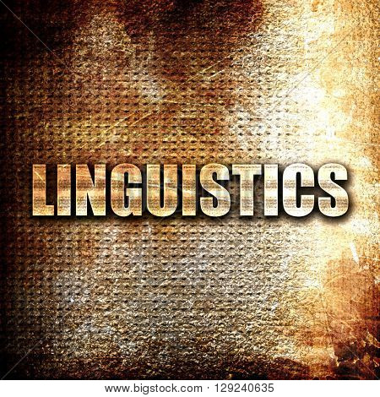
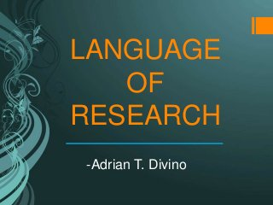
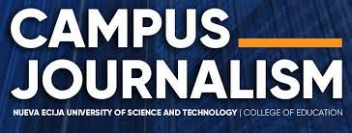
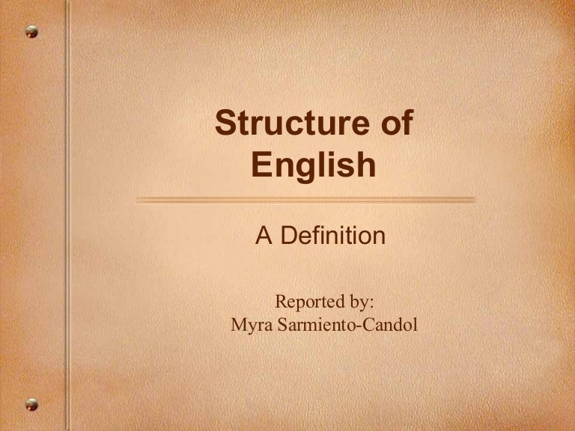
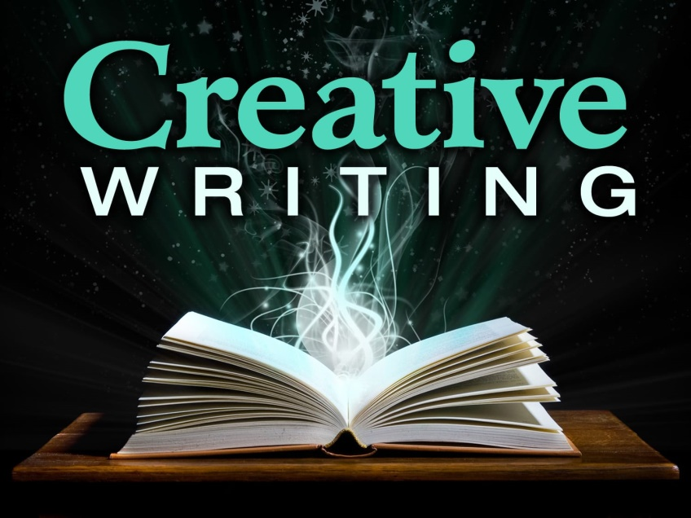
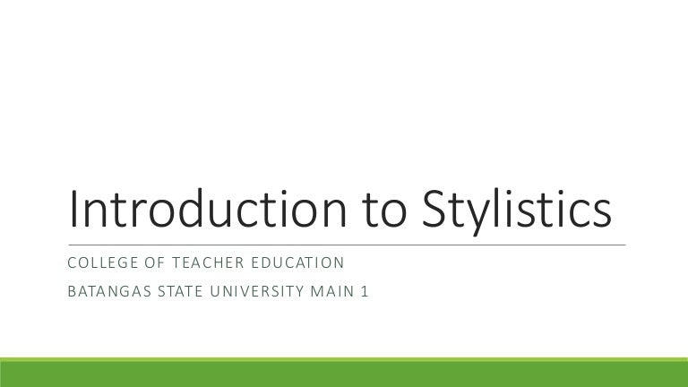
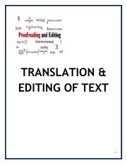
LET REVIEW – ENGLISH MAJOR
EDUARDO C. MIRA, Ph.D.
Program Head, Bachelor of Arts in Journalism
Student Publication Adviser
JRMSU – Dipolog

Slide 2

INTRODUCTION OF LINGUISTICS

Slide 3

Linguistics
It refers to the scientific study of language and how it works.
The word ‘linguistics’ is derived from the Latin words ‘lingua’ meaning ‘tongue’ and ‘istics’ meaning ‘knowledge’.
According to the Cambridge Dictionary, linguistics refers to ‘the scientific study of the structure and development of language in general or of particular languages’.
The study of linguistics comes from the natural curiosity of man about the particulars of the language he speaks, evaluated through different perspectives.
LET REVIEW – ENGLISH MAJOR

Slide 4
Scope of Linguistics
Linguistics involves a vast, complex and systematic study, with different core areas such as phonology, phonetics, morphology, syntax and semantics. It is also intertwined with various other disciplines and contains fields like sociolinguistics, psycholinguistics , and among others.
Phonemes
Syllables
Morphemes
HIERARCHY OF LANGUAGE
Words
Phrases
Clauses
Sentences / Utterances
Text / Discourses
LET REVIEW – ENGLISH MAJOR

Slide 5
Language Viewed
Structuralists. They believe that language is a structured system of components, an idea with a specific framework.
Transformationalists. Language for the transformationalists is a generative and creative process. Language pervades creativity since it is more abstract and has more reflective elements.
Functionalists. They view language as an instrument for communication and a vehicle for expression. They argue that structures can be best analyzed when referred to the functions they carry-out in a communicative context.
Interactionists. They view language as a product of a human desire to communicate with another and acquire the language with one desire to learn. They believe that human genetics provides an individual the capability to produce language and his or her social interactions make him or her master the language.
LET REVIEW – ENGLISH MAJOR

Slide 6
Branches of Linguistics
DIVISIONS OF TWO BROAD FIELDS
I. Micro-linguistics
PHONOLOGY studies the system of sounds within a language or between different languages. It is primarily concerned with the systematic organization of sounds especially in spoken languages. It studies the patterns of sounds in a language, how speech sounds are organized, an how they are used to convey meaning.
MORPHOLOGY studies the forms of words in different uses and constructions. It is studied under two fields, namely, inflectional morphology and derivational morphology. On the other hand, morphology focuses on the study of morphemes, the smallest meaningful unit of a language0
LET REVIEW – ENGLISH MAJOR

Slide 7
I. Micro-linguistics
SYNTAX studies the construction of phrases, clauses and sentences in a language. It analyses the basic word order followed in languages. If morphology studies how words are formed, syntax deals with how sentences are structured.
SEMANTICS is a study of meaning. It focuses on studying the structure of meaning in a language and in giving an account of word and sentence meaning. It encompasses morphological meaning and the combined meaning of syntactical structures.
PRAGMATICS is an extension of semantic and deals with the study on how meaning changes with different contexts It focuses on their contextual meaning. Pragmatics deals with meaning beyond the surface or literal level - - - that is, it focuses more on the intended meaning for the speaker rather than what the sentences literally mean.
LET REVIEW – ENGLISH MAJOR

Slide 8
Branches of Linguistics
DIVISIONS OF TWO BROAD FIELDS
II. Macro-linguistics
Sociolinguisitcs, deals with the study of the effects of the different social and cultural factors on the use of language. It examines the patterns and variation in language within a society or community.
Psycholinguistics focuses on the interrelation between linguistic and psychological factors that enable humans to understand, acquire, and use language.
Computational linguistics studies the application of computer science in the analysis of language and speech and other linguistic studies.
Historical linguistics is a branch of linguistics that is also known as diachronic which deals with the study of language change or change of a group of languages over time, including phonological, grammatical, and semantic changes.
LET REVIEW – ENGLISH MAJOR

Slide 9
II. Macro-linguistics
Applied linguistics concerns with the application of language studies in real life, such as in language teaching and learning. It is a broad term referring to the range of activities that involve in the solving of some language-related problems and concerns.
Comparative linguistics is a sub-field of historical linguistics that is primarily concerned with comparing languages to establish their similarities especially in identifying whether or not they have a common ancestral language.
Structural linguistics focuses on the study of language as an independent network of formal systems or structures. It is based o theories and principles that language is composed of structural units such as lexical and syntactic elements.
Biolinguistics is an interdisciplinary study involving other disciplines such as biology, linguistics, psychology, and neurolinguistics, primarily aims to explain the evolution and formation of language.
LET REVIEW – ENGLISH MAJOR
LET REVIEW – ENGLISH MAJOR

Slide 10
II. Macro-linguistics
Clinical linguistics is a sub-discipline of applied linguistics that focuses on the application of linguistic concepts and theories in the field of Speech-Language Pathology. It involves the description, analysis, and treatment of language disabilities and disorders.
Development linguistics studies the development of the linguistic ability of an individual especially children. It focuses on how children acquire language in childhood, such as acquisition of syntax and other linguistic elements.
Linguistic typology aims to classify languages based on their structural and functional components. It focuses on describing the diversity of the language in the world especially in terms of their properties and structures.
LET REVIEW – ENGLISH MAJOR

Slide 11
II. Macro-linguistics
Neurolinguistics studies the relationship between language and the structures and functions of the brain. It aims to analyze the different brain functions and mechanisms that are related to language comprehension, production, and acquisition.
Stylistics deals with the study on how different individuals or social group use language in all types or forms, spoken or written in their communication. Stylistics is also called a literary linguistics because it studies the different authors and writers especially on their writing styles as they use a variety of literary techniques and devices to provide distinctiveness and variety in their writing especially, but not exclusively, in different literary works and genres.
Etymology investigates the origins of words, their birth, and development, often delineating their spread from one language to another and their evolving changes in form and meaning.
LET REVIEW – ENGLISH MAJOR

Slide 12
Linguistic Theories and Models
BEHAVIORISM
The behaviorists, most notably BF Skinner, believe that for language learning to occur, imitation, drills, and constant practice are very vital. Behaviorists demand that language teachers must be proficient enough or possess native-like fluency so that what will be taught to the learners are only the perfect ones.
NATIVISM / INNATISM
Noam Chomsky, the main proponent of nativism, criticized the imitation and stimulus-response learning principles of behaviorism for its failure to explain why, with limited knowledge of grammatical rule, people are able to generate limitless number of sentences. With this notion, Chomsky hypothesized that humans must be born with Language Acquisition Device (LAD) in their brain which is the reason why children can acquire language quickly. He argued that LAD contains the universal rules by which human languages operate. He called this set of rule as a Universal Grammar (UG) or mental grammar which allows us to “feel” unconsciously whether or not our utterance or sentence is well-formed.
LET REVIEW – ENGLISH MAJOR

Slide 13
Linguistic Theories and Models
INTERACTIONISM
Proponents of interactionism assert that language acquisition has both biological and social components - - - that is, it is the result the application of the principles propounded by the behaviorists and nativists. The interactionists believe that there must be a good interplay between the biological and environmental factors for language acquisition to occur.
MONITOR MODEL
Another idea supporting the principle that acquiring a language has both biological and social components is Stephen Krashen’s monitor model, also known as the input hypothesis, which is composed of five hypothesis or components expounding the process of language acquisition namely; The Acquisition–Learning Hypothesis, Natural order Hypothesis,
The Monitor Hypothesis, The Input Hypothesis, and Affective-filter Hypothesis).
LET REVIEW – ENGLISH MAJOR

Slide 14
Distinctions of Linguistic Approaches
Descriptive versus Prescriptive
A. Don’t say “I speak English.”
B. You don’t speak English, you say “I speak in English.”
Notice how sentence A is presented. This sentence is an example of descriptive language commonly and conventionally used by many speakers around the world; thus, descriptive approach is a linguistic distinction that describes and analyzes language according to how people verbally use it.
The prescriptive approach, on the other hand, lays down the correct way of the structural arrangement of the words in the sentence. It is an approach based on what is considered to be structurally correct and accurate as determined by the group of academic. This approach shows a complete disregard of how language community speaks. Certain forms of language are more “accurate” than others based on the social prestige of the users.
LET REVIEW – ENGLISH MAJOR

Slide 15
Distinctions of Linguistic Approaches
Synchronic versus Diachronic
Synchronic manifests when studying the language structures or when exploring how words are combined.
Diachronic is focused on historical linguistics. It also concentrates on the difference between two or more two languages over the centuries or decades.
For instance, when you study how language evolves through time, and make a comparative analysis of old English and the present English language, the study us diachronic. It involves exploring how historical events affect the language.
Langue versus Parole
Langue is the intangible linguistic scheme used by all the members of a speech community. It refers to the set of rules and patterns which people need to follow.
Parole is the concretization of language through the actual use. Language is concretized using the rules and set of conventions, while parole is naturally occurring and concrete.
LET REVIEW – ENGLISH MAJOR

Slide 16
Distinctions of Linguistic Approaches
Language Competence versus Language Performance
According to Chomsky, competence is the speaker’s knowledge of the grammatical rules of language while performance is the actual use of language and application of the grammatical rules.
Language competence makes the speakers compose a chain of sentences in different structural patterns and allows them to recognize errors when they are committed as well as vague constructions and fragments. Language Performance is not stable in the sense that it is always dependent on the circumstances of the speaker, which includes social, psychological, and physical factors.
Speech versus Writing
Speech is primary; writing is secondary. Writing the record of the language represented in letters. Speech involves the articulation of language using the speech organs and the reception of the message. Writing follows a written code, which gives the language a different characteristics and scope that speech does not have. In writing, the message is carried through a certain space or channel, which is preserved and used through time.
LET REVIEW – ENGLISH MAJOR

Slide 17
References
Franklin, V., Rodman, R., & Hyams, N. (2014). An Introduction to language (10 b.). Boston:
Cengage Learning.
Gonzales, J. & Enoc, J. 2021). Introduction to linguistics. Quezon City: Lorimar Publishing, Inc.
Hebert, L. (2011). The functions of language. Signo. Rimouski. Quebec Universite de
Quebec a Rimouski
Jakobson R. & Halle, M. (1956). Fundamentals of language. Mouton.
Krashen, S. D. (1981). Second language acquisition and second language learning. University
of Southern California.
Larsen-Freeman, D. & Celce-Murcia, M. (1999). The grammar book: an ESL, EFL Teacher’s
Course.
LET REVIEW – ENGLISH MAJOR

Slide 18

STRUCTURE OF ENGLISH

Slide 19

Phonology
It is the study of speech sounds.
It looks into the patterns of sounds in a particular utterance and across languages.
It scrutinizes the difference between languages by exploring what sounds what sounds could go together to make patterns and form into words.
It investigates the different processes such as how objects and sounds are mentally presented in human brains. It identifies some categorical organizations of speech sounds in the minds and how they are used to convey messages.
Note: Through the study of phonology, we understand how language is decoded in human brains when we are producing or receiving messages.
LET REVIEW – ENGLISH MAJOR

Slide 20
Phonetics deals with the definite production and acoustics of the sounds of language. It looks into the speech production and the interaction of the different organs of speech such as the teeth, the tongue, the lips to articulate a certain sound. It is the study of the physical qualities of speech.
Phonemics looks into the structure of language in terms of phonemes or its distinct units of sounds. A phoneme is the smallest unit of sound in a specific language that differentiates one word from another, as examples, the sounds of /p/, /d/, /b/, /t/ in words pat, dab, pad, bad, and tab.
An allophone is predictable phonetic variations or any speech sounds that stand as a single phoneme, such as the aspirated /k/ in “kit”, and the unaspirated /k/ in “skit”, which are allophones of the phoneme /k/, or the aspirated /t/ in “top” and unaspirated /t/ in “stop” and the flap sound of the /tt/ in <<battery>> are allophones of phoneme /t/.
In English the t sounds in the words “hit,” “tip,” and “little” are allophones; phonemically they are considered to be the same sound although they are different phonetically in terms of aspiration, voicing, and point of articulation.
LET REVIEW – ENGLISH MAJOR

Slide 21
Articulation is the production of sounds using the vocal tract, such as the articulation of the sounds of vowels and consonants.
Phonation occurs when the air is carried into the lungs. The air passes through the glottis and the larynx.
Phone the actual sound of a word that you can hear and is represented in phonology with square brackets surrounding it.
An example can be the word puff, so when you speak the word aloud, that sound is called the phone. So you are speaking out the word’s mental presentation, the phoneme, which is a symbol representing the sound and makes an actual sound.
This is represented in the symbol that is written in the square brackets, and it is written as it sounds, like this: [pʌf]
LET REVIEW – ENGLISH MAJOR

Slide 22
Nasalization occurs when the sound is expelled partly through the nose and the mouth, such as the sound of /n/.
THREE BRANCHES OF PHONETICS
Articulatory phonetics studies the production of speech sounds by the human vocal tract.
Auditory phonetics studies the perception of speech sounds by the human perceptual system.
Acoustic phonetics studies the physical properties of speech sounds.
Two main classes
I. Vowels
A vowel is a speech sound that is syllabic and pronounced without any restrictions in the organs. It is one of the major classifications of sound. It varies in loudness, quality and length. Vowels are voiced. It is involved in prosodic distinction including stress, tone and intonation. Vowels are primarily represented by letters: a, e, i, o, u.
LET REVIEW – ENGLISH MAJOR

Slide 23
II. Consonants
Consonants are speech sounds that are articulated with partial or complete closure of the vocal tract.
Examples of consonants are:
[p] – (produced with the lips)
[t] – (produced with the front of the tongue)
[k] – (produced with the back of the tongue)
[h] – (produced in the throat)
[f] and [s], – (produced forcing air through a narrow channel)
[m] and [n], - the air goes through the nose.
Suprasegmental Features
Suprasegmental features are prosodic features which include stress, tone, pitch, juncture, and intonation.
Transcription refers to the symbolic and visual representation of speech sounds. The International Phonetic Alphabet is usually the most common transcription that us utilized by many linguistics. Below is the guide for transcription
LET REVIEW – ENGLISH MAJOR

Slide 24
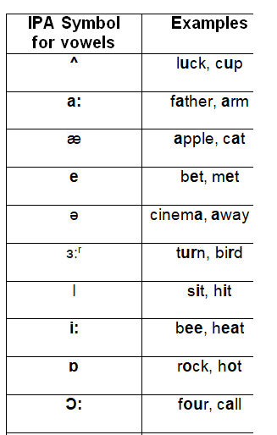
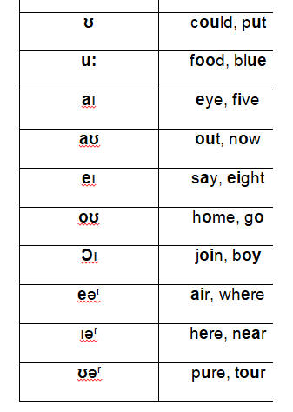
LET REVIEW – ENGLISH MAJOR

Slide 25
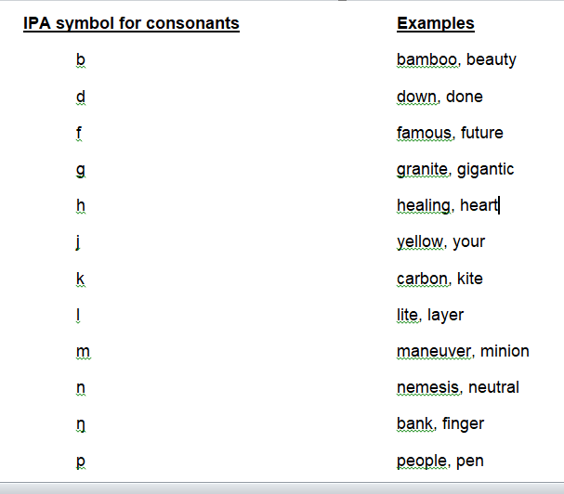
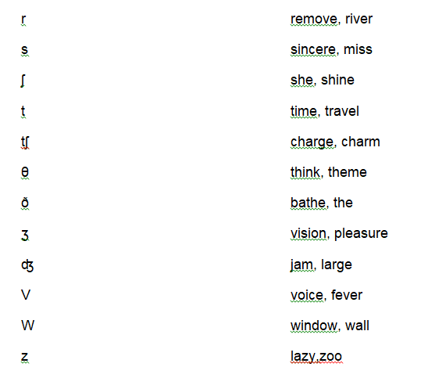
LET REVIEW – ENGLISH MAJOR

Slide 26
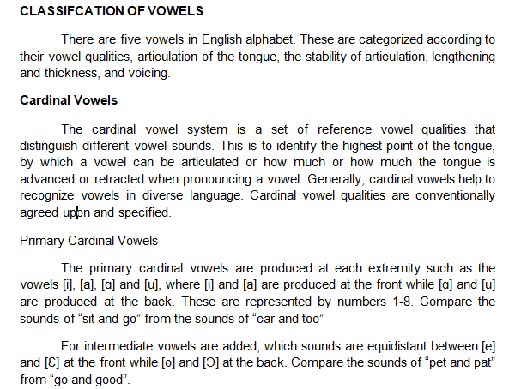
LET REVIEW – ENGLISH MAJOR

Slide 27
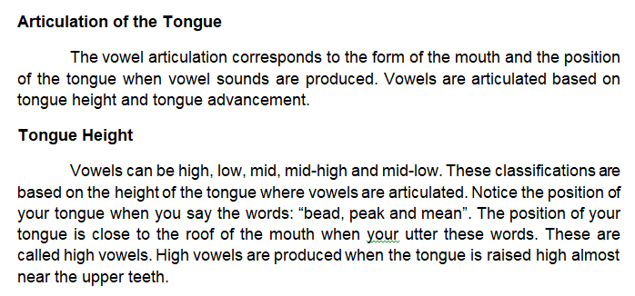
LET REVIEW – ENGLISH MAJOR

Slide 28
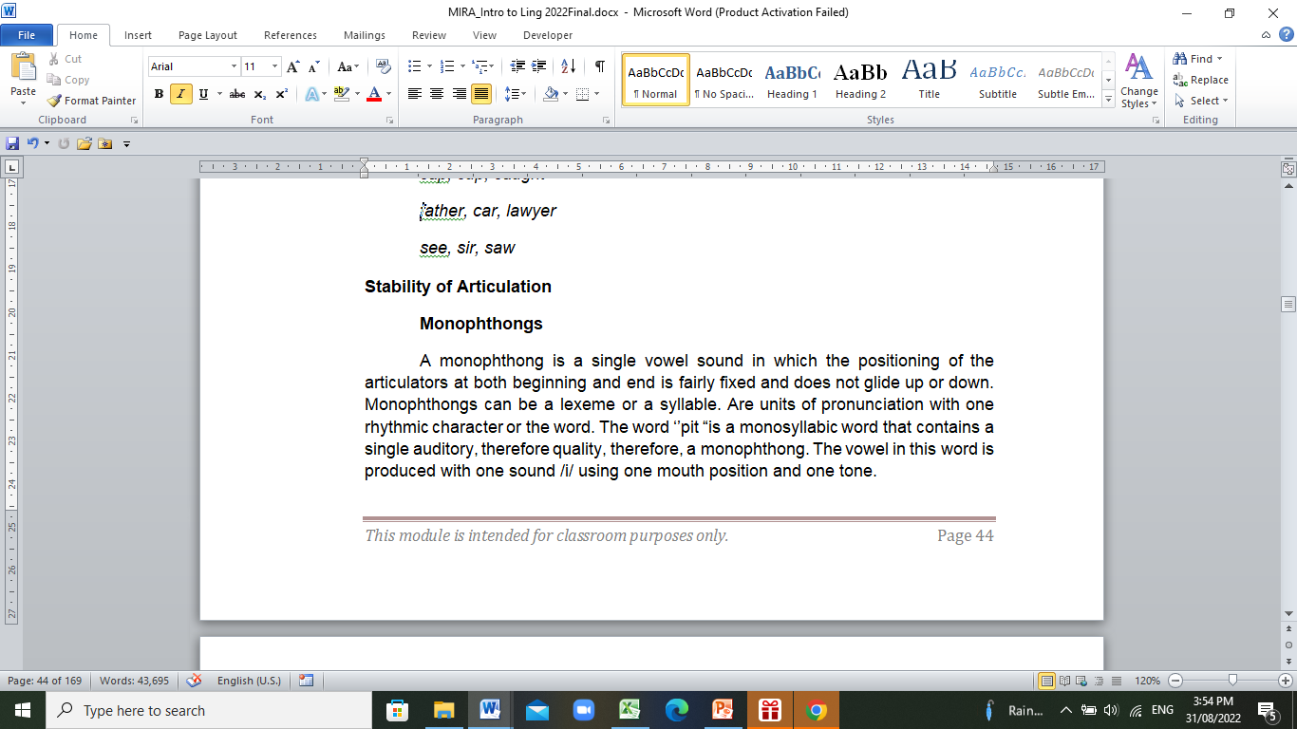
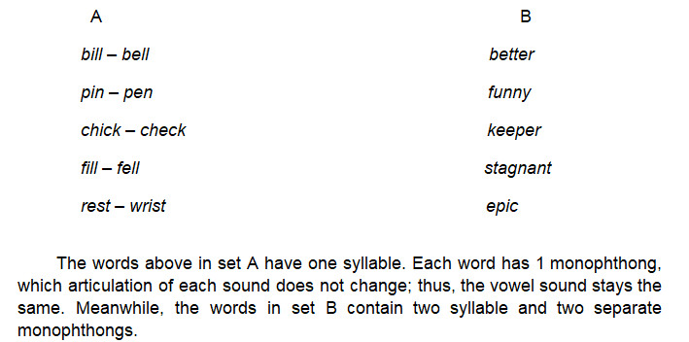
LET REVIEW – ENGLISH MAJOR

Slide 29
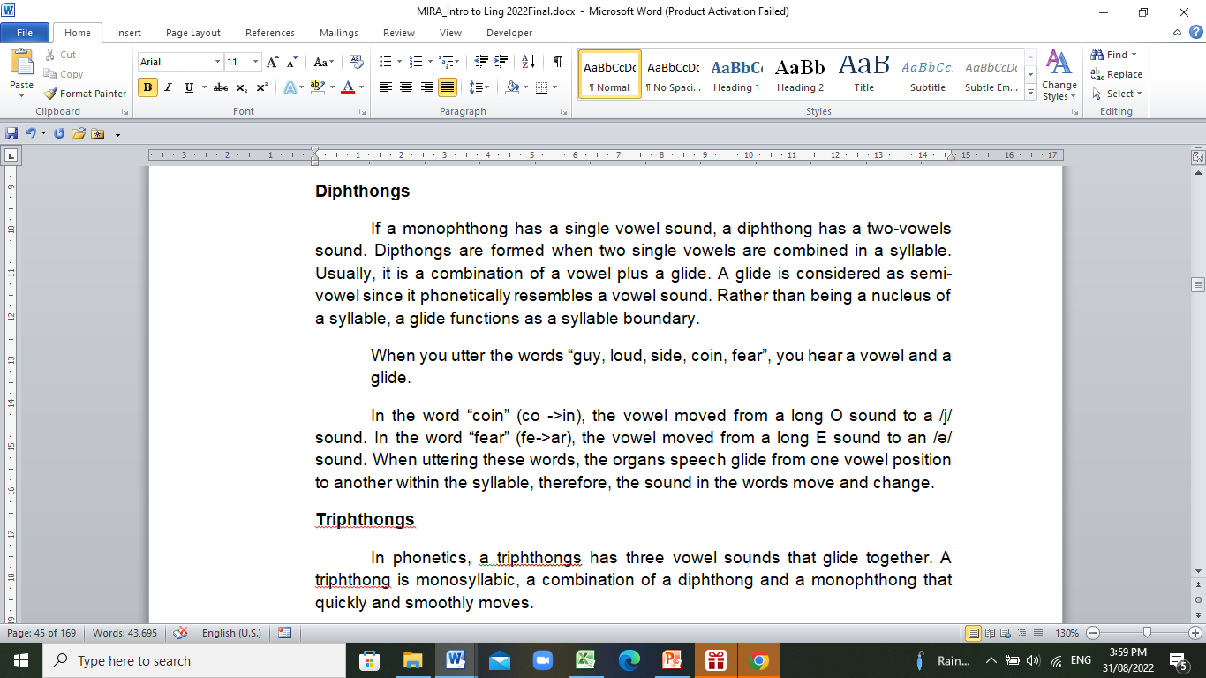
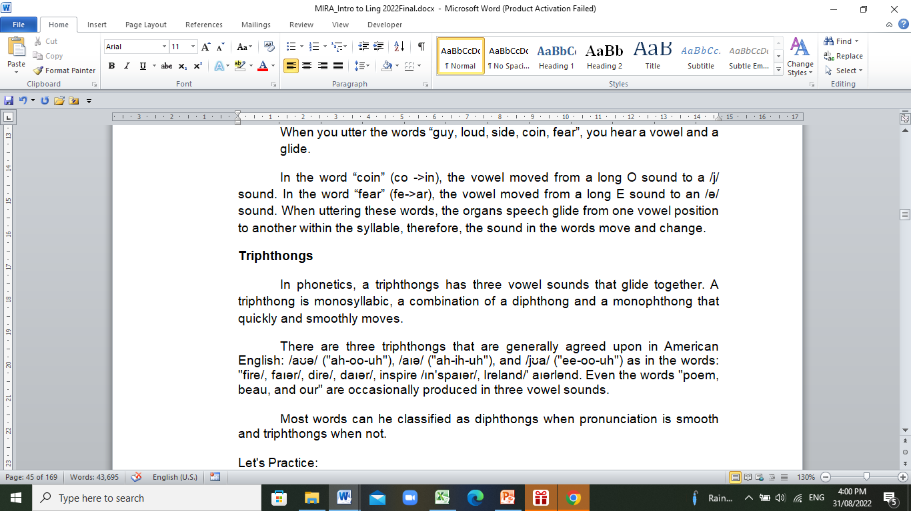
LET REVIEW – ENGLISH MAJOR

Slide 30
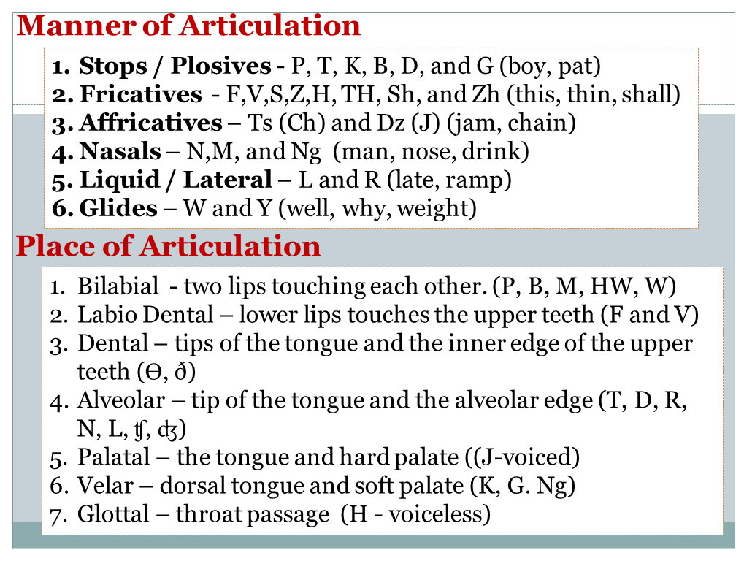
LET REVIEW – ENGLISH MAJOR

Slide 31
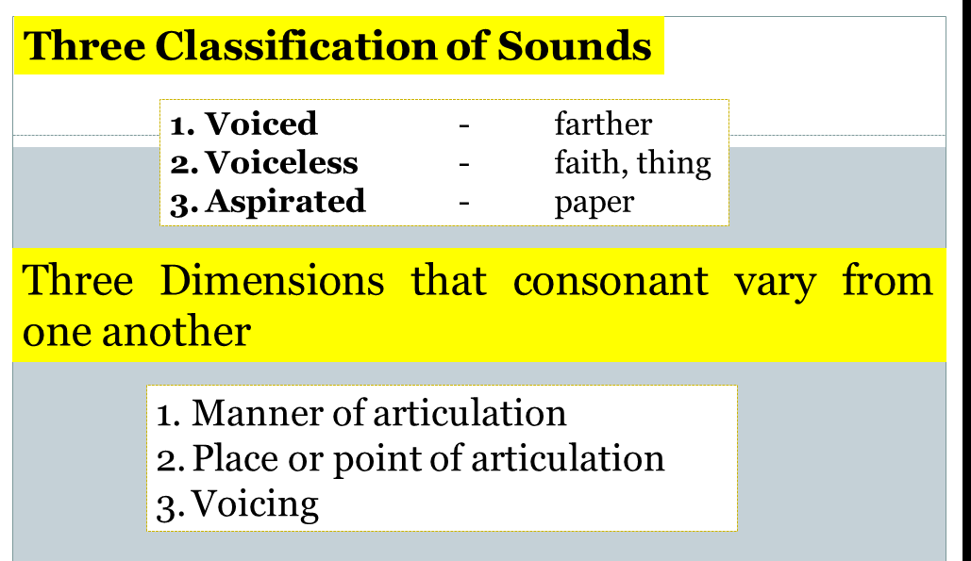
LET REVIEW – ENGLISH MAJOR

Slide 32
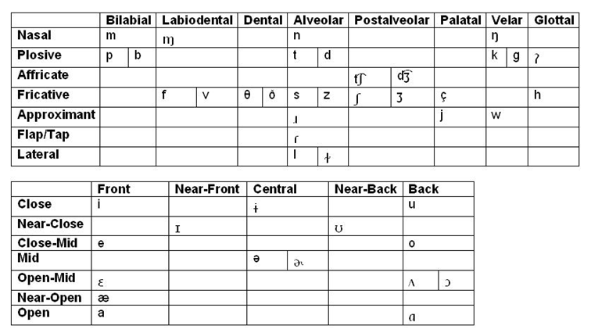
LET REVIEW – ENGLISH MAJOR

Slide 33
7 TYPES OF PHONOLOGICAL RULES
1. ASSIMILATION – phonological process in which a sound changes to resemble a nearby sound and can occur both forward and backward.
Ex. The prefix in- where sometimes it appears as in– and others as im-. In front of bilabial words, in– becomes im-. This also happens across word boundaries, like in between pronounced with an m.
2. DISSIMILATION – phonological process in which two close sounds changes to become less alike.
Ex. Manner dissimilation where a stop becomes a fricative when followed by another stop. The word sixth is pronounced sikst, /sθ/ becomes /st/.
3. INSERTION – phonological process in which a sound is added to a word.
Ex. Voiceless stop insertion where between a nasal consonant and a voiceless fricative, a voiceless stop with the same place of articulation as the nasal consonant is inserted. In English, many say hampster instead of hamster, a /p/ is added.
LET REVIEW – ENGLISH MAJOR

Slide 34
4. DELETION – phonological process in which speech sounds disappear from words.
Ex. English is a fast/common speech language, so vowels can be deleted to make the word one syllable, and easier to pronounce in a fast manner. Police becomes plice, and friendship is said as frienship.
5. METATHESIS – phonological process in which sounds switch places in the phonemic structure of a word.
Ex. To make words easier to pronounce and understand, letters are switched. Two historical examples include Old English (brid and aks) becoming Modern English (bird and ask).
6. STRENGTHENING (fortition) – phonological process in which a sound is made stronger.
Ex. Aspiration is where voiceless stops become aspirated when they occur at the beginning of a stressed syllable. Top is said with as h.
7. WEAKENING (lenition) – phonological process in which a sound becomes weaker.
Ex. The definition of flapping is before a stressed vowel and before and unstressed vowel where the sound is pronounced with articulation resembling a flap. The word kitty is an example where the alveolar stop is realized as /r/.
LET REVIEW – ENGLISH MAJOR

Slide 35
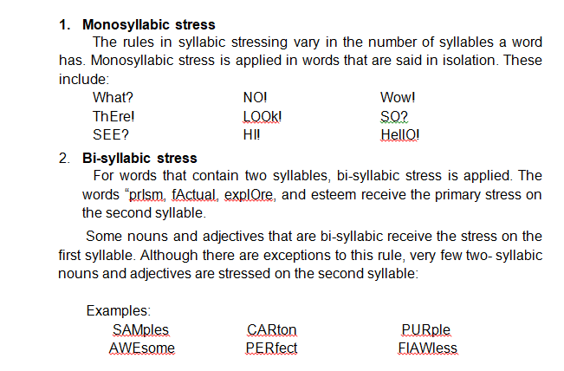
SUPRASEGMENTAL includes stress, pitch, intonation, juncture, and blending.
Stress is putting relative emphasis to a certain syllable of a word or to a certain word in a phrase or sentences. In words, the stress falls on the vowels sounds, which is affected by the articulation of vowel sounds such as length and pitch. Some dictionaries use stress symbols such as ( ‘ ) that indicate primary stress, and ( ^ ) or ( , ) as secondary stress.
LET REVIEW – ENGLISH MAJOR

Slide 36
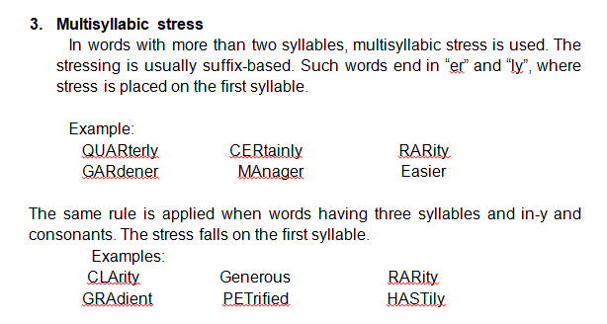
LET REVIEW – ENGLISH MAJOR

Slide 37
A. Morphology
It is referred to as the study of patterns of word formations. It looks into the meaningful structural unity of words. In greater sense, it comprises the analysis, identification and categorization of the lexical grammatically of a certain language, its specific linguistic units, the morphemes, the roots words, the affixes, and other means of word creation.
Morpheme
It is the smallest unit of language meaning. It is not further dividable or separate into smaller forms. It could either be added to another morpheme to form a specific meaning, such as affixes, or it could mean something by itself. When a morpheme carries its meaning, it is called a root.
Examples:
Impurity (Im+pure+ity)
Unmanly (Un+man+ly)
Encouragement (En+courage+ment)
LET REVIEW – ENGLISH MAJOR

Slide 38
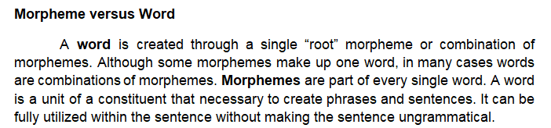
Morph
It is the phonetic realization of a morpheme or the way a morpheme is formed.
It is a concrete while a morpheme is abstract. A morph is also seen as a sequence of phonemes.
It is a string of phonemes that cannot be divided into smaller units.
It is the smallest unit that carries meaning both in writing and in sound.
Examples:
It represents one morpheme such as the word “courageous”, which consists of three morphs: “cou-ra-geous”. Each of these morphs represents one morpheme.
LET REVIEW – ENGLISH MAJOR

Slide 39
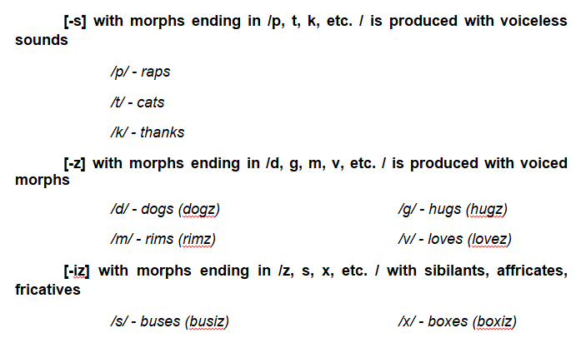
Allomorph
It is a morph that has a unique set of lexical features.
Allomorphs are the distinct variant of the same morpheme.
They differ in shape and pronunciation according to their conditions and functions.
They are a class of morphs that are semantically identical like the morpheme[s], which is phonologically conditioned such as:
LET REVIEW – ENGLISH MAJOR

Slide 40
ROOT, STEM, AND BASE
A root is a morph which the component of a word-form that is intact when all affixes are removed. Roots are always present in every meaningful linguistic unit. In the form “unstoppable”, the roots is “stop” where the affixes “un and able”, are attached. Significantly, there are two roots in the word “armchair”, the “arm” and the “chair”
A stem is concerned with inflectional morphology. Most words are stems, where affixes can be attached. In the word “unstoppable”, the stem is “stoppable”, which could be broken to a smaller stem “stop”.
Examples:
stop (infinitive)
stop (imperative)
stops (present, 3rd person, singular)
stopped (simple past)
stopped (past participle)
stopping (progressive)
LET REVIEW – ENGLISH MAJOR

Slide 41
A base is any form to which affixes can be attached. It is the core unit of each word that has no extra parts. This signifies that any stem or any root can be called a base, however, not all bases are stem or root.
An example is the base “cycle”, which is a word with concrete meaning, but could also transform into motorcycle, cyclist, bicycle, which carry a different meaning.
In terms of MORPHOLOGICAL AFFIXATION, there two types.
a. Bound morphemes which cannot stand alone (e.g. un-, -ly, -ed, re-. in-)
b. Free Morphemes which can stand alone (e.g. like, happy, jump, write)
- Content words (open class) – noun, verb, adjective, and adverb)
-Function words (closed class) – pronoun, conjunction, preposition,
determiner
When we talk about words, there are two groups: lexical (or content) and function (or grammatical) words. Lexical words are called open class words and include nouns, verbs, adjectives and adverbs. New words can regularly be added to this group. Function words, or closed class words, are conjunctions, prepositions, articles and pronouns; and new words cannot be (or are very rarely) added to this class.
LET REVIEW – ENGLISH MAJOR

Slide 42
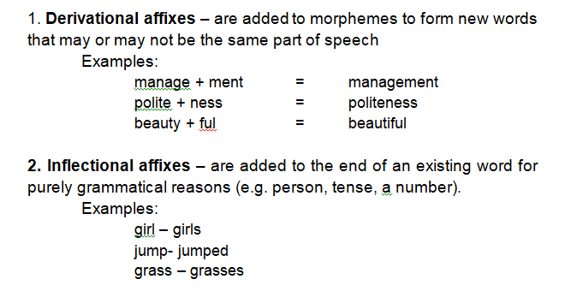
Affixes are often the bound morpheme. This group includes prefixes, suffixes, infixes, and circumfixes. Prefixes are added to the beginning of another morpheme, suffixes are added to the end, infixes are inserted into other morphemes, and circumfixes are attached to another morpheme at the beginning and end.
Prefix: re- added to do produces redo
Suffix: -or added to edit produces editor
Infix: -um- added to fikas (strong) produces fumikas (to be strong) in Bontoc
Circumfix: ge- and -t to lieb (love) produces geliebt (loved) in German
LET REVIEW – ENGLISH MAJOR

Slide 43
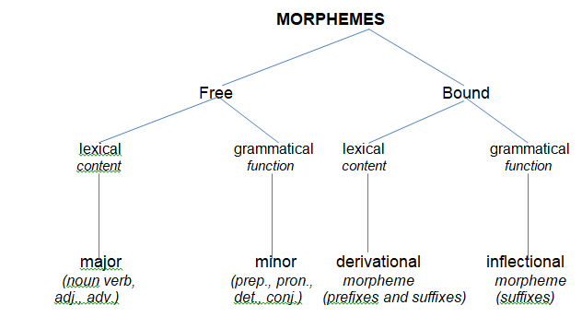
Morphology Diagram of Morphemes
LET REVIEW – ENGLISH MAJOR

Slide 44
Word Formation Process
It refers to the means of creating new words which observe certain structural formulas and semantic configurations.
1. Derivation. Word derivation is the process of forming words by adding derivational affixes to the base or root word to form a new word.
Adding suffixes such as:
-hood (status)
Ex. brotherhood, motherhood etc.
-ship (state or condition)
Ex. friendship, ownership etc.
-ness (quality, state or condition)-ity (state or condition)
Ex. wildness, carelessness, curiosity, toxicity
-ment (result or product of doing the action)
Ex. government, achievement
-al (act of something)
Ex. refusal, perusal etc.
LET REVIEW – ENGLISH MAJOR

Slide 45
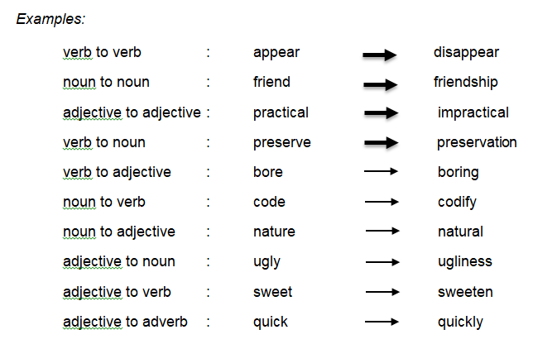
Derivation produces new words having similar grammatical form, such as noun to noun, or of different grammatical forms, such as verb to noun.
LET REVIEW – ENGLISH MAJOR

Slide 46
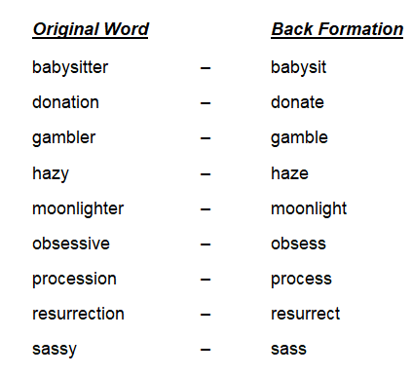
2. Back Formation. It is the opposite of word derivation. New lexemes are created by removing affixes and shortening some words.
LET REVIEW – ENGLISH MAJOR

Slide 47
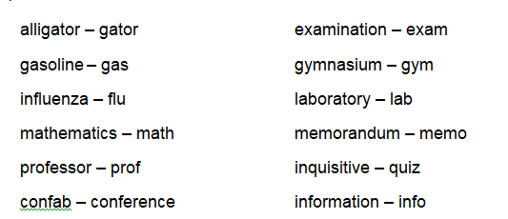
3. Clipping. It is a process of word formation in which an existing word is reduced or shortened usually to a single syllable without changing the meaning of the word. Clipping is distinguished from back-formation in a way that the meaning of the original word is kept.
LET REVIEW – ENGLISH MAJOR

Slide 48
4. Coinage. It is a word-formation process where a certain word is created through brand names of the items people usually use until it becomes a generic name.
Examples:
Aspirin Escalator Heroin Band-aid
Factoid Frisbee Google Kerosene
Kleenex Laundromat Linoleum Muggle
Nylon Psychedelic Quark Xerox
5. Blending. It is a blend of two or more words to generate a new one. In blending, parts of two or more words are combined to build a new word meaning of which is often a combination of the original words.
advertainment (advertisement + entertainment)
biopic (biographical + picture)
chortle (chuckle + snort)
prissy (prim + sissy)
simulcast (simultaneous + broadcast)
telethon (telephone + marathon)
webinar (web + seminar)
LET REVIEW – ENGLISH MAJOR

Slide 49
6. Compounding. It is a word-formation using a combination of two or more lexemes. Compound words maybe written as two words joined by a hyphen or one word.
notebook (note + book) noun + noun
workroom (work + room) verb + noun
breastfeed (breast + feed) noun + verb
bittersweet (bitter + sweet) adjective + adjective
stir-fry (stir + fry) verb + verb
7. Conversion. In some languages, it is possible to form new lexeme merely by shifting the word category without adding any affixes.
My friend bottled (v) the soda and the canned (v) the sardines.
Billy filled the soda in a bottle (n) and the sardines in a can (n).
He microwaved (v) his dinner by heating his food in a microwave (n).
My mother eyed (v) my swollen eye (n).
LET REVIEW – ENGLISH MAJOR

Slide 50
8. Acronyms. These are words formed from the initials of certain names
laser – Light Amplification by Stimulated Emission of Radiation
PAG-ASA - Philippine Atmospheric, Geophysical and Astronomical Services
DAR - Department of Agrarian Reform
RADAR – Radio Detection and Ranging
9. Initialism. It is a type of abbreviation that uses the first letters of words in a phrase to make a term, which may or may not be pronounced as a new word.
DTI – Department of Trade and Industry
SMA – Saint Mary’s Academy
NBI- National Bureau of Investigation
DA- Department of Agriculture
JRMSU – Jose Rizal Memorial State University
LET REVIEW – ENGLISH MAJOR

Slide 51
10. Eponyms. These are words created from the names of real or fictitious characters. These are from proper nouns which involve some degree of change in the meaning of the word.
atlas – Atlas boycott – Charles C. Boycott
cereal – Ceres jacuzzi – Candido Jacuzzi
nicotine – Jean Nicot pasteurization – Louis Pasteur
volcano – Vulcan
11. Borrowing. It is also called loan word, is common in the English language. These borrowed words are from other languages.
balcony, opera, violin, spaghetti, macaroni (Italian)
ketchup, dimsum, laisee (Chinese)
iceberg, kindergarten, hamburger, pretzel (German)
sushi, karaoke, tycoon, karate, soy, tsunami (Japanese)
sofa, coffee, candy, mattress, magazine, cotton (Arabic)
estafa, sari-sari, high-blood, carnap, halo-halo, gimmick (Filipino)
LET REVIEW – ENGLISH MAJOR

Slide 52
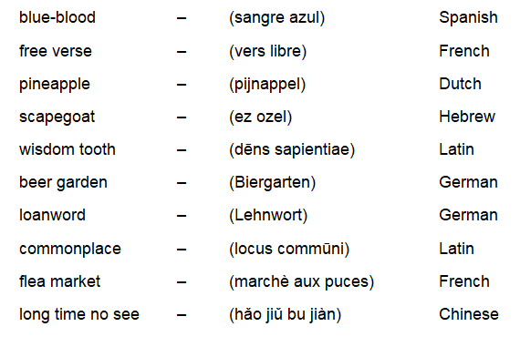
12. Calquing. It is also called loan translation. It is closed to borrowing however, the borrowed word is translated from the original to another language that fits the characteristics of a new word.
LET REVIEW – ENGLISH MAJOR

Slide 53
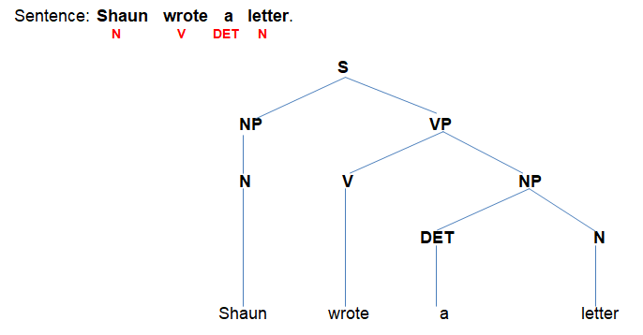
SYNTAX
SYNTAX is basically the analysis of sentences while MORPHOLOGY is the analysis of words. In general, SYNTAX AND MORPHOLOGY make up the CORE OF GRAMMAR.
SYNTAX is concerned with the ways words go together to form sentences and how words are used related to one another.
LET REVIEW – ENGLISH MAJOR

Slide 54
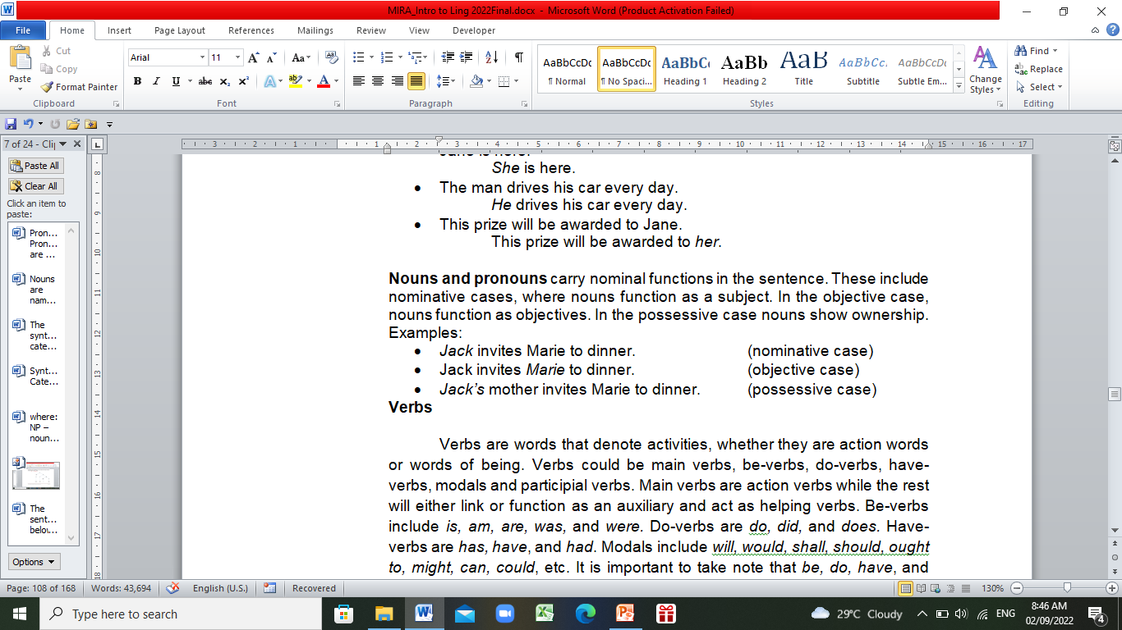
Syntactic Categories
1. NOUNS are names. These names may be abstract or concrete. Anything that names a concrete object, person, place, thing, and animal or an abstract idea, feeling, and sentiments is a noun.
2. PRONOUNS are noun substitutes. They are often used in the sentence to avoid mentioning the same noun repeatedly.
LET REVIEW – ENGLISH MAJOR

Slide 55
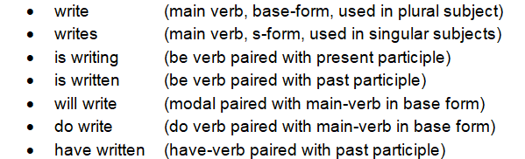
3. VERBS are words that denote activities, whether they are action words or words of being. Verbs could be main verbs, be-verbs, do-verbs, have-verbs, modals and participial verbs. Main verbs are action verbs while the rest will either link or function as an auxiliary and act as helping verbs. Be-verbs include is, am, are, was, and were. Do-verbs are do, did, and does. Have-verbs are has, have, and had. Modals include will, would, shall, should, ought to, might, can, could, etc. It is important to take note that be, do, have, and modals serve both the main verb and the auxiliary verb.
LET REVIEW – ENGLISH MAJOR

Slide 56
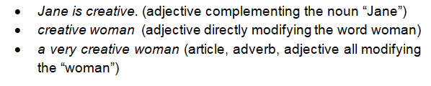
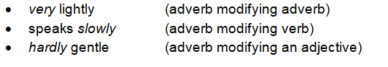
4. ADJECTIVES are modifiers of nouns and pronouns. They either directly precede the nouns or complement the nouns or pronouns. Adjectives are words that describe.
5. An ADVERB is a syntactic category or a word that modify and adjective, a verb or another adverb.
LET REVIEW – ENGLISH MAJOR

Slide 57
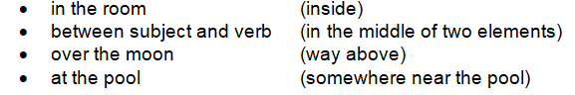
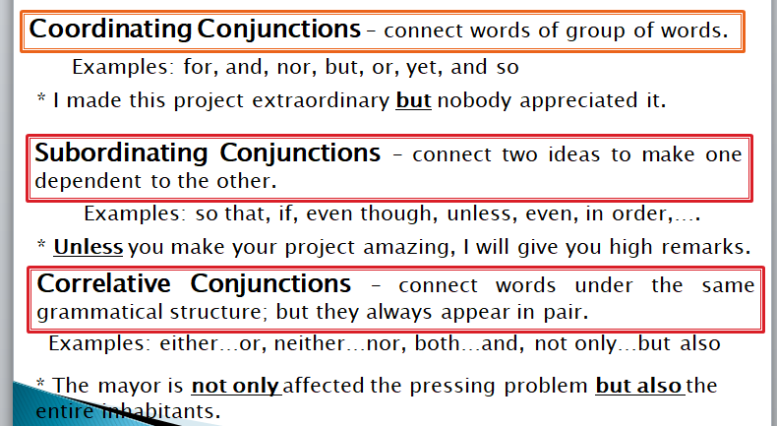
6. A PREPOSITION is a syntactic category that states the location.
7. CONJUNCTIONS are connectors that link the words, phrases, or clauses. They are classified into three.
LET REVIEW – ENGLISH MAJOR

Slide 58
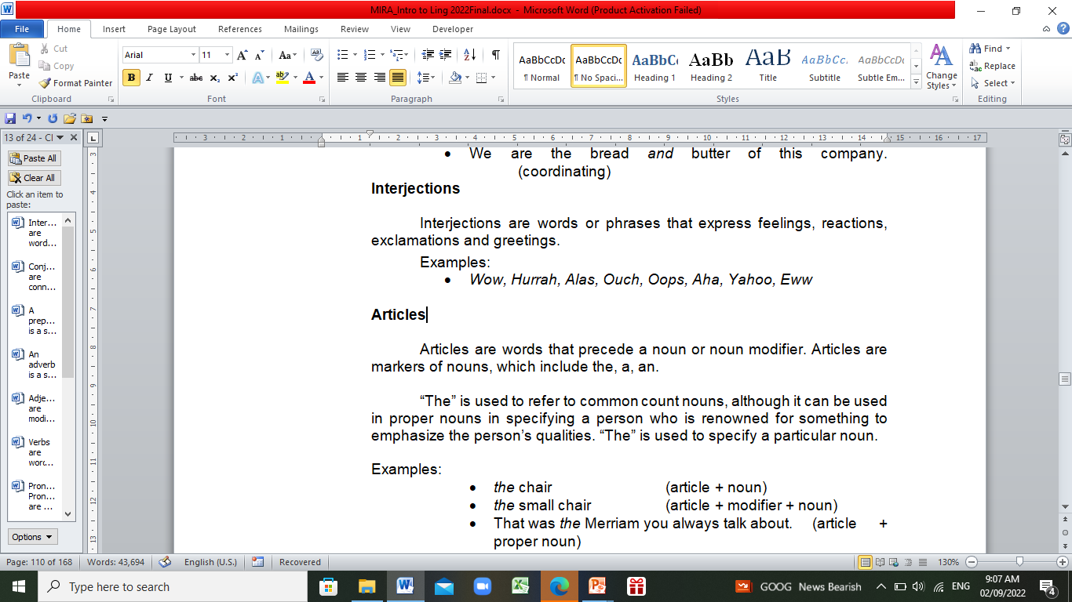
8. INTERJECTIONS are words or phrases that express feelings, reactions, exclamations and greetings.
9. ARTICLES are words that precede a noun or noun modifier. Articles are markers of nouns, which include the, a, an.
the chair (article + noun)
the small chair (article + modifier + noun)
a man (article + non-specific noun)
a tall man (article + modifier + non-specific noun)
An apple (article “an” + noun that begins with a vowel letter)
An amazing-looking apple (article “an” + modifier that begins with vowel letter)
LET REVIEW – ENGLISH MAJOR

Slide 59
Syntactic Unit
It is the unit or form of syntax that includes words phrases, clauses and sentences.
A. Word. It is a basic meaningful unit of speech writing. It is also created through a single root morpheme or combination of morphemes.
analyze (free morpheme)
this (free morpheme)
grateful (free + bound morpheme)
consciousness (free + bound morpheme)
Honest (free morpheme)
B. Phrase. It is a series of words that do not constitute a complete thought. A phrase could be a noun phrase, verb phrase, adjective phrase, adverb phrase, and prepositional phrase.
LET REVIEW – ENGLISH MAJOR

Slide 60
B.1. Noun phrase. It is consists of a single modifier and noun or a series of modifiers, the head of which is the noun.
A bird (determiner + noun)
A beautiful bird (determiner + adjective + noun)
A very beautiful bird (determiner + adverb + adjective + noun)
B.2. Verb phrase. It is a syntactic unit, which start with a verb and all the cluster of words that follow. A verb phrase functions as a predicate of the subject.
She sings.
She sings a beautiful song.
She sings with grace.
She is singing in front of the audience
B. 3. Adjective phrase. It consists of an adjective and all the cluster of words around it that modify a noun or pronoun.
The show was not so awful.
She was extremely surprised by the gift.
Your style is very interesting.
You are nothing but awesome.
LET REVIEW – ENGLISH MAJOR

Slide 61
B. 4. Adverbial phrase. It is composed of adverbs and all the clusters of words around functioning as one unit in describing a verb, adjective or adverb.
He is speaking so loudly.
I tried to explain it quickly.
You talk very convincingly.
B. 5. Prepositional phrase It is a structure that starts with a preposition and ends with a noun.
He stays in his room. I keep it in my pocket.
I read it on the post.
B. 6. Conjunctional phrase. It is a structure that conducts the function of a conjunction.
Jessa is not only fashionable but also elegant.
Neither I nor he drinks alcohol.
We will start the program as soon as everyone comes.
B. 7. Interjectional phrase. It is a structure that functions as interjections which include statements that express emotions, greetings, hesitations, etc.
My goodness!
Oh no!
Thank God!
LET REVIEW – ENGLISH MAJOR

Slide 62
Clause
It is a series of words that contain a subject and verb phrase which is classified as dependent or independent.
INDEPENDENT CLAUSES (These are clauses found in simple or compound sentences. These clauses can stand by themselves). | DEPENDENT CLAUSES (These are clauses that cannot stand on their own and need another clause to be complete).
He ran fast. | He ran fast, so he will not be caught.
He is a man and she is a woman. | She is the woman whom he made a promise to.
I am finishing my work. | I was finishing my work when you arrived.
LET REVIEW – ENGLISH MAJOR

Slide 63
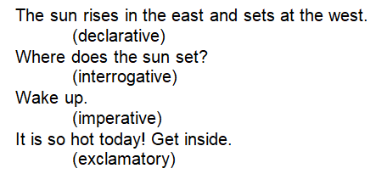
Sentence
It is made up of a word or phrase that makes a complete thought.
Sentences are categorized according to purpose and function.
I. According to purpose, a sentence could be declarative, interrogative, imperative and exclamatory.
LET REVIEW – ENGLISH MAJOR

Slide 64
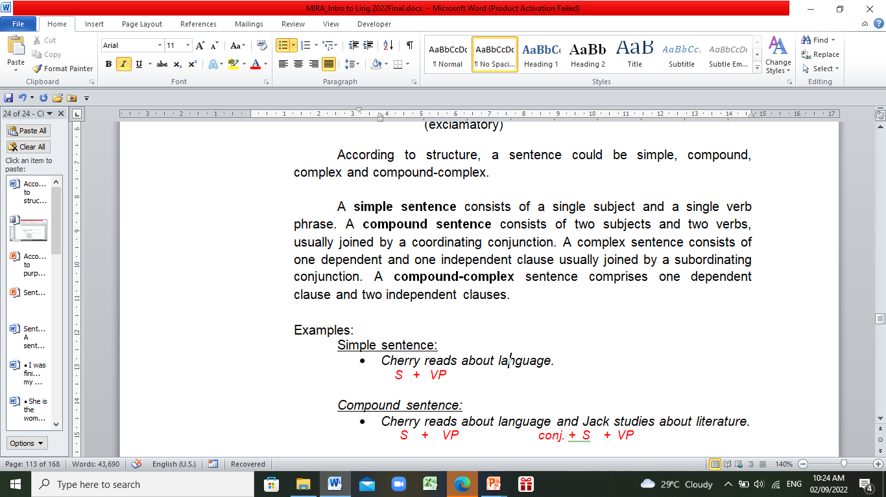
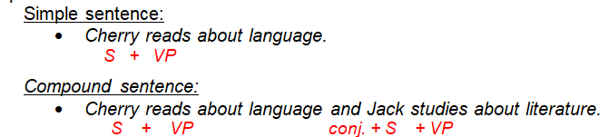
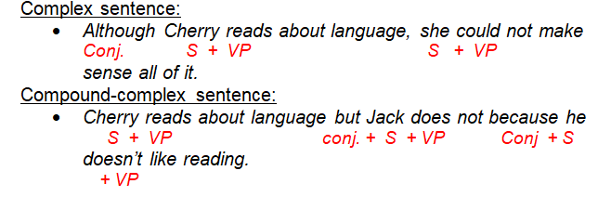
II. According to structure, a sentence could be simple, compound, complex and compound-complex.
LET REVIEW – ENGLISH MAJOR

Slide 65
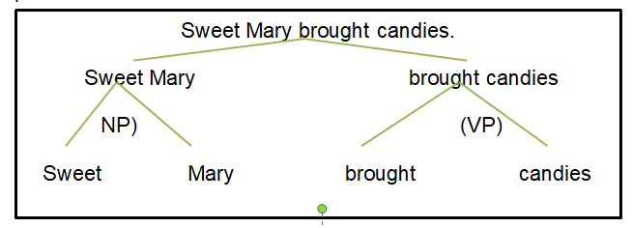
Constituency
The PRINCIPLE OF CONSTITUENCY describes that certain groups of words from close units. A CONSTITUENT is a word or group of words that serves as a single unit within the grammatical structure. It could be a morpheme, a word, phrase, or clause. All words and phrases within the sentence are constituents of that particular sentence.
LET REVIEW – ENGLISH MAJOR

Slide 66
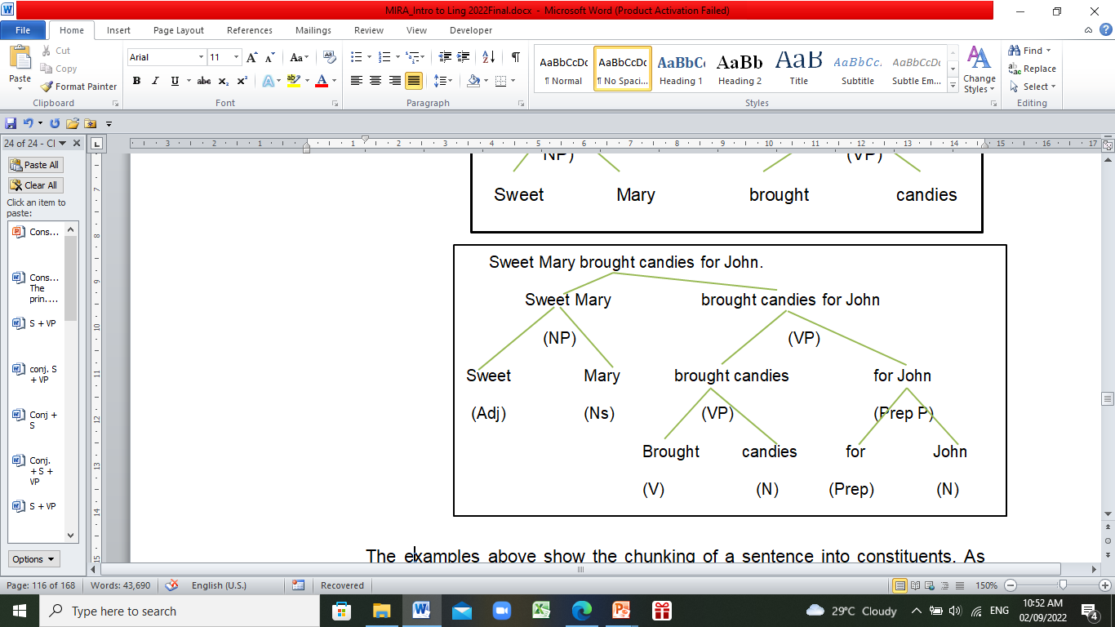
The examples show the chunking of a sentence into constituents. As shown, a sentence is built upon noun and verb phrase which stems to minor constituents. Leonard Bloomfield (1933) called the process as Immediate Constituent Theory.
LET REVIEW – ENGLISH MAJOR

Slide 67
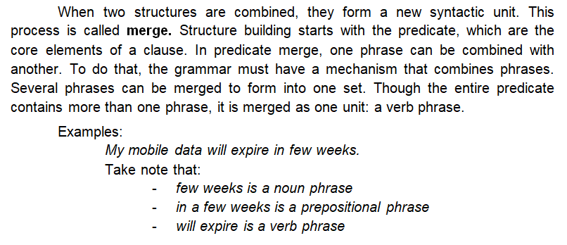
Merge
LET REVIEW – ENGLISH MAJOR

Slide 68
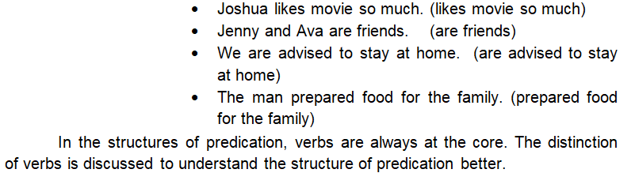
A combination of subject and predicate or the doer of the action and the action itself makes-up a sentence. Predicates always give more information about the subject. They could be simple or a series of phrases. To find the predicate in the sentence is to always look at what the subject is doing.
A. Structures of Predication
LET REVIEW – ENGLISH MAJOR

Slide 69
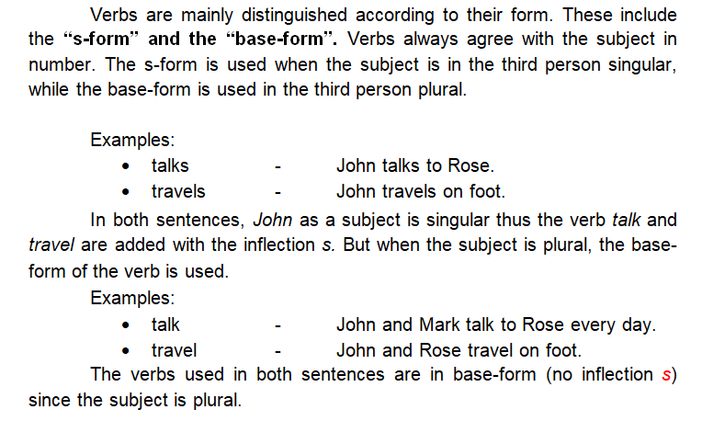
DISTINCTION OF VERBS
FORMS
LET REVIEW – ENGLISH MAJOR

Slide 70
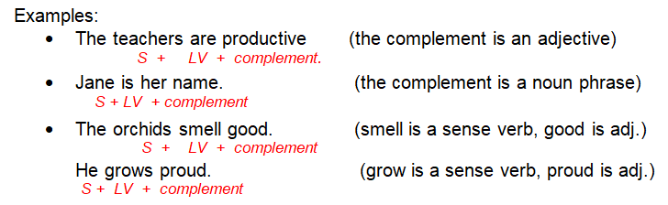
Kinds and Functions
1. LINKING VERBS are also called copulative verbs. These are verbs that connect a subject to a complement. Linking verbs include be-verbs that link the subject to the complement such as is, am, are, and were. Linking verbs also involve the verbs that appeal to the senses.
LET REVIEW – ENGLISH MAJOR

Slide 71
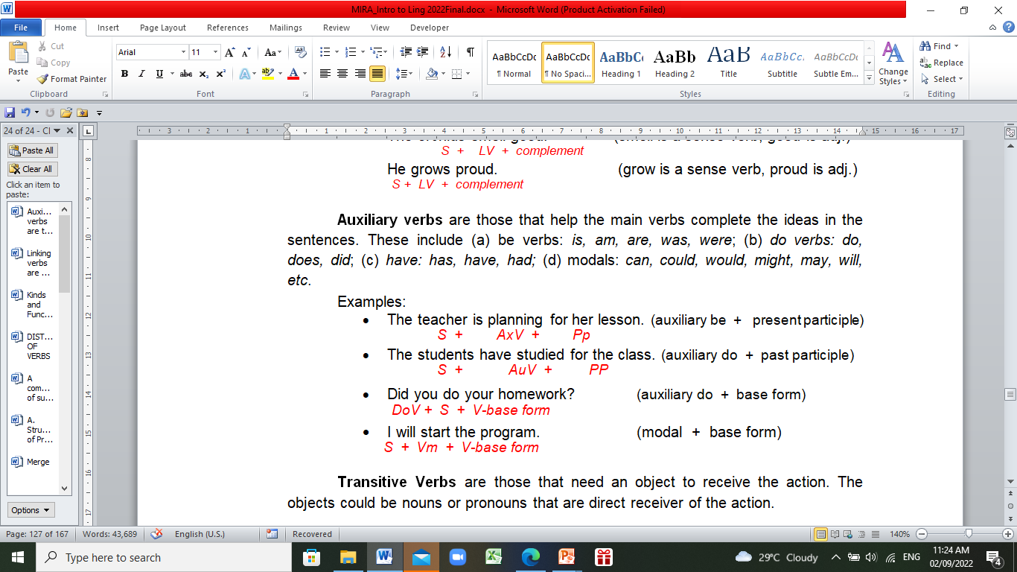
2. AUXILIARY VERBS are those that help the main verbs complete the ideas in the sentences. These include (a) be verbs: is, am, are, was, were; (b) do verbs: do, does, did; (c) have: has, have, had; (d) modals: can, could, would, might, may, will, etc.
LET REVIEW – ENGLISH MAJOR

Slide 72
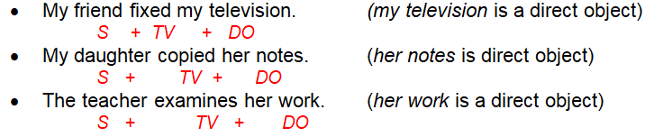

3. TRANSITIVE VERBS are those that need an object to receive the action. The objects could be nouns or pronouns that are direct receiver of the action.
4. INTRANSITIVE VERBS are those that do not need an object to receive the action. A prepositional phrase may be added after the intransitive verb, which, when deleted, would not change the message of the sentence.
LET REVIEW – ENGLISH MAJOR

Slide 73


5. DITRANSITIVE VERBS are verbs that allow two objects such as nouns and pronouns to complete the meaning.
6. ERGATIVE VERBS are verbs that may or may not require object nouns and pronouns to complete the message.
LET REVIEW – ENGLISH MAJOR

Slide 74

7. PREPOSITIONAL VERBS are verbs that need prepositions to complete the ideas. This includes verb-preposition combinations. Verb-preposition combination may form phrasal verbs and idioms.
LET REVIEW – ENGLISH MAJOR

Slide 75

Modification is the use of words or phrases to show further information or description about a thing, a person, a place, an action, or any quality being labeled. The element of higher significance in the sentence is called the head, while the accompanying element is called the modifier. These make up the structure of modification.
B. Structures of Modification
LET REVIEW – ENGLISH MAJOR

Slide 76
Adjective modifiers may come in series, where words of different grammatical labels have one grammatical function: adjective modifying a noun.
these four little ginger kittens (pronoun, number, size, color + noun)
the first three eager applicants (article, ordinal, cardinal, quality + noun)
a cheap black plastic bag (article, cost, color, material + noun)
Nouns and verbs are usually the head of the phrase, but not at all times. The head also includes other grammatical categories such as adjective as head, and adverb and preposition as a head.
I am so happy to see you. (adjective head)
I would like to see you very soon. (adverb head)
I dropped it straight down the drain. (preposition as head)
LET REVIEW – ENGLISH MAJOR

Slide 77

SUMMARY OF MODIFICATION
LET REVIEW – ENGLISH MAJOR

Slide 78
It is a syntactic structure that joins together two or more elements called conjoins or conjuncts. The conjoins are linked by a coordinator or conjunction, which signals the coordination.
C. Coordination
The structure is said to be syndetic if the elements are joined by coordinating conjunctions.
The structure is asyndetic when the coordinators are not necessarily present but could be inserted.
Polysyndetic on the other hand is when the coordinator is reoccurring between each pair of units.
She wakes up early but she came late. (syndetic)
She wakes up early, (yet) she came late. (asyndetic)
She wakes up fast and early and she arrived to school on time. (polysyndetic)
LET REVIEW – ENGLISH MAJOR

Slide 79

Conjunctive adverbs are used as a linking verbs device between elements or ideas. They denote the logical relationship between clauses and sentences. The functions of conjunctive adverbs are either connect or contrast ideas or indicate results.
Conjunctive adverbs include:
LET REVIEW – ENGLISH MAJOR

Slide 80
A structure of complementation is a verb phrase comprising two major components: a verbal component (VB) and a complement (C). The verbal component may be a finite verb or verb phrase, or a non-finite verb in the form of an infinitive, an infinitive without to” or a present participle.
D. Complementation
Complement Structure Categories
1. An object complement is a predicative expression that follows a direct object or states what the “object” has become.
Objective complement could be a single word indefinite pronoun, a single noun, an infinitive verb phrase, a gerund, or a clause.
She sees the pen. She desires writing the story
An object complement is also a combination of an indirect and direct object. The pattern is: subject + transitive verb + indirect object + direct object
The judges awarded him first prize.
Another structure of an objective complement is a combination of a transitive verb, a direct object, and an object of the preposition. The pattern is: subject + transitive verb + direct object + object of preposition.
(The judges awarded him first prize.) absence of to
LET REVIEW – ENGLISH MAJOR

Slide 81
SEMANTICS
It concerns with the aspects of meaning that are encoded by word and grammar.
It deals with the conceptual meaning of words and sentences.
Try to analyze the three following sentences
Sorry, I didn’t mean to offend you.
Is that what you mean?
Semantics means ‘simasiologia’ in Greek.
In (1), mean is equivalent of ‘intend’, in (2) it means to convey a message, and in (3) it is a translation. The examples just show that even the seemingly very common word like mean can mean different things.
LET REVIEW – ENGLISH MAJOR

Slide 82

LET REVIEW – ENGLISH MAJOR

Slide 83

LET REVIEW – ENGLISH MAJOR

Slide 84
Lexical Relations
WORDS are categorized especially in terms of the sounds and structures that make up them up. This way contributes to the characterization of their meaning. However, there is another way of characterizing their meaning – that is by way of identifying its relationship to other words or lexical relations.
1. SYNONYMY (most commonly understood lexical relation)
Synonyms are words with similar or very closely related meanings. Hence, oftentimes, but not always, they are intersubstitutable in sentences. Examples of synonyms include small – tiny, big – huge, fast – quick, wealthy – rich, and many more.
2. ANTONYMY. Antonyms are words with opposite meanings. Commonly used examples are big – small, happy-sad, long-short, rich-poor, hot-cold, true – false. There are two main types of antonyms – gradable or continuous and non-gradable or categorical.
LET REVIEW – ENGLISH MAJOR

Slide 85
3. HYPONYMY. Hyponymy describes a hierarchical relationship between words. If we can say that the meaning of word “x” is embedded in the word “y”, or if x is a kind of y, a hyponymous relationship between x and y exist.
An example is when a pupil is asked about what dolphins are, the pupil answered that dolphins are mammals. In this case, the child identifies the dolphins as mammals.
4. HOMONYMY. ‘Homonyms’ is the broad term used to describe words that are homophones or homographs, or both. Hence, from this definition words such as sea (body of water), see (to watch) and row (argument), row (propel with oars), row (a linear arrangement) are homonyms.
Words are homophones if they are pronounced identically but have different meanings and regardless of spellings. If they have the same spelling then they are also homographs (and homonyms). Examples are sea – see, know – no, meat – meet, cell – sell, male – mail, pale – pail.
LET REVIEW – ENGLISH MAJOR

Slide 86
5. POLYSEMY. Words that have related meanings and have the same spelling and pronunciation are technically known as polysemy.
Few examples are the words ‘head’ and ‘mouth’ that have multiple meaning which are all related by extension; head – the top part of the body, someone on top of a department or company, and on top of a glass of beer; mouth – part of the human body and that of animals, or the opening of a cave or river.
6. METONYMY. Aside from polysemy, there is another type of lexical relationship that uses a term to stand for another word, idea, or concept. This close association or connection between words is called metonymy.
We can find some examples of metonymy in everyday communication. We use ‘crown’ to refer to the king and his rule, the Malacanang Palace for the President of the Philippines and the federal government, the Wall Street for the U.S economy, and many others.
LET REVIEW – ENGLISH MAJOR

Slide 87
7. IDIOMS. Idioms are types of collocations that are made up of words in a fixed order and their meaning cannot be taken from the sum of the individual words, unlike the regular collocations.
For example: pass the back which means to pass the blame or responsibility for something to someone else.
LET REVIEW – ENGLISH MAJOR

Slide 88
PRAGMATICS
Pragmatics focuses on the aspects of meaning that cannot be predicted by our semantic knowledge alone, thus taking into account our knowledge and experience of both the physical and social world. In other words, it is concerned with utterance meaning.
Speaker meaning vs. Sentence meaning
The sentence meaning is the literal meaning of a sentence.
Speaker meaning, is the meaning that a speaker intends that may be well beyond the sentence conceptual meaning.
LET REVIEW – ENGLISH MAJOR

Slide 89

LET REVIEW – ENGLISH MAJOR

Slide 90

LET REVIEW – ENGLISH MAJOR

Slide 91

LET REVIEW – ENGLISH MAJOR

Slide 92

LET REVIEW – ENGLISH MAJOR

Slide 93
The Cooperative Principle
Four Maxims (Grice, 1989)
Paul Grice, an English language philosopher, argues that our utterance is a potential interference in the rights, thoughts, and wishes of our listeners.
The Maxim of Quantity. In this maxim, we are reminded that in our talk exchange with people we have to just say enough, nothing more, nothing less. Our contribution must also be informative but just enough, not more informative, as is required of the purpose of the exchange. Hence, we violated this maxim if we said too little, or if we said more than is necessary.
The Maxim of Quality. There is one supermaxim of quality – that is, we have to be truthful. Based on this supermaxim, there are two specific maxims or submaxims: (1) We should not say what we believe to be false. Since we cannot be sure all the time that what we are going to say is true, the best thing that we should do is to say only what we believe to be true. (2) We should not say anything that we are not sure of or if we lack adequate evidence. We should avoid saying things that we cannot back up with supporting evidence.
LET REVIEW – ENGLISH MAJOR

Slide 94
The Maxim of Relation. This maxim is also called the maxim of Relevance, following its two-word dictum that we must “Be relevant.” To be relevant means that in a conversation, we should say things related not only to the context of the discourse but also to the context of the situation. In other words, we must not include irrelevant information.
The Maxim of Manner. How we express our thoughts matters in a talk exchange. Often, problems in communication such as misunderstanding or miscommunication occur because of language ambiguity and obscurity of expression. To avoid these problems, we should be perspicuous – that is, we should communicate clearly. We should also use language that is easy to understand. Let us avoid language which can be interpreted in multiple ways. In our communication, we should provide information in a concise manner and orderly fashion. Lastly, let us always “Seek first to understand and to be understood.”
LET REVIEW – ENGLISH MAJOR

Slide 95
Speech Act Theory
This THEORY has been studied by J.L. Austin (975). He claimed that we do not only use our words to present or state information, but also carry out actions. He called this the Speech Act theory. SAT is further developed by J.R. Searle, an American philosopher.
A SPEECH ACT is defined as the ‘force’ in words that forces us to do or act.
We use it to describe actions such as requesting, commanding, questioning, apologizing, informing, declaring, etc.
THREE KINDS OF SPEECH ACT THEORY
A. LOCUTIONARY ACT is an act of performing an utterance with its intended meaning and hence of a speech act.
Example: Don’t do that!
This statement shows that someone is told not to do something, hence a locutionary act with its distinct phonetic, syntactic, and semantic aspects of the utterance.
LET REVIEW – ENGLISH MAJOR

Slide 96
B. AN ILLOCUTIONARY ACT is said to be the true speech act. The act expresses an illocutionary force that carries the intended speaker meaning. If locutionary act is what was said and meant, illocutionary is what has to be done or what was done.
five illocutionary speech acts
ASSERTIVES – where speakers assert their intention and beliefs on the proposition by making statements that can be verified as either true or false;
DIRECTIVES – speech act that are intended to get someone to do what the speaker desires, such as requests and commands;
COMMISSIVES – speech acts of committing to some future actions, such as promises and oaths;
EXPRESSIVES – speech acts that express speaker’s attitudes and emotions manifested through the utterances, such as excuses and thanks; and
DECLARATIONS – speech acts that change the propositional content corresponding with reality, such as baptisms, pronouncing someone guilty or pronouncing someone husband and wife
LET REVIEW – ENGLISH MAJOR

Slide 97

1. They pledge to recycle as much waste as possible at home.
2. The lawmakers affirm the importance of this Bill.
3. If you go and see this movie I recommend that you don’t eat first.
4. I declare the nominations closed.
5. We congratulate you Mr. President for the success of your foreign
Let’s practice!
LET REVIEW – ENGLISH MAJOR

Slide 98
C. A PERLOCUTIONARY ACT denotes the effects on the listener through performing the illocutionary act. These speech acts have an effect on the feelings, thoughts, or actions of the speaker, of the listener, or of other persons. The effects are special to the context or occasion and may or may not be what the speaker intended.
In the utterance “By the way, I have some chocolate candies here; would you like some?” its illocutionary function is an offer, while its intended perlocutionary effect might be to simply express generosity or to show a friendly attitude.
LET REVIEW – ENGLISH MAJOR

Slide 99

As a summary…
LET REVIEW – ENGLISH MAJOR

Slide 100
SOCIOLINGUISTICS is concerned with language in its social context. - - - the relations between language and the society.
PSYCHOLINGUISTICS investigates the mental processes underlying the language processing.
NEUROLINGUISTICS is biologically oriented, focusing on the brain’s language processing attitude
TYPOLOGY seeks to discover and account for the variation by classifying languages into types according to some structural features and classifying linguistic structures according to their similarities and differences.
LET REVIEW – ENGLISH MAJOR

Slide 101

Introduction to stylistics

Slide 102

It is a method of textual representation in which primary of place is assigned in language (Simpson, 2004).
It is the application of concepts from linguistics and allied disciplines in the analysis and interpretation of communication through language (Otanes, ms.).
It is the study of literary discourse from a linguistic orientation. *Widdowson, 1975).
STYLISTICS
COMMON ELEMENTS OF STYLE
Word Choice. The style manifests itself through words - - - the kinds of words selected by the writer and in their arrangement proper words in their proper words.
Sentence Structure. The main point of writing through which style is revealed the unit in which a writer arranges his words.
Paragraph Patterns. The best and about the shortest unit if composition in which style can be seen advantageously; it is the chief unit of development, of movement and of rhythm,
Structure
intrinsic (employed in a short composition and appropriate to the familiar essay
extrinsic (employed logical arrangement of ideas and in a formal essay, formal structure.
LET REVIEW – ENGLISH MAJOR

Slide 103
COMMON ELEMENTS OF STYLE
Movement. It is the way in which a literary work develops as it progresses.
Time. It is the dominant qualities of style are mainly determined by tone.
Imagery. It can make something abstract, like an emotion or theory, seem more concrete and tangible to the reader. By using imagery, writers can evoke the feeling they want to talk about in their readers.
Allusions. These are used as stylistic devices to help contextualize a story by referencing a well-known person, place, event, or another literary work.
Phrasing. It is the way in which something is put into words. It is related to the concept of phraseology, which can be defined as the way in which words and phrases are organized into larger components (or chunks).
Sound Patterns. These connections create meaning patterns. Three of these sound patterns shall be considered in more detail here: alliteration, assonance and onomatopoeia
Rhythm. Languages use rhythms composed of syllables that are variously stressed and unstressed, all in a variety of patterns that, though discernible and often complex under analysis, we mostly use unconsciously.
Visual Devices. visual language is a system of communication using visual elements. These also help users perceive and comprehend visible signs.
LET REVIEW – ENGLISH MAJOR

Slide 104
Types of Stylistics
A. Linguistic Stylistics is primarily concerned with the use of language and its effects in a text. It has to do with a stylistic study that relies heavily on the scientific rules of language in its analysis.
Linguistic stylistics, however, looks for style in terms of linguistic features of a text at different levels of linguistic description like phonology (onomatopoeia, alliteration, eye dialect, and rhyme), syntax (repetition, and question in the narrative), grammar (dialect), and semantics (metaphor, irony, and simile).
B. Literary Stylistics is primarily concerned with messages and the interest in codes (languages) lies in the meaning they convey in particular instances of use. The beauty of language and how it issued to capture reality is also the focal concern of literary stylistics
LET REVIEW – ENGLISH MAJOR

Slide 105
Functional Styles of English Language
1. Classification of Language Styles
Publication Style. It is used in public speeches and printed works, which are addressed to a broad audience and devoted to important social or political events, public problems of cultural and moral character.
b. Official Documents. Official documents are written in a formal, “cold” or matter-of-fact style of speech. The style of official documents, or ‘officialese’ as it is sometimes called, is not homogeneous and is represented by the following sub-styles, or varieties:
the language of business documents,
the language of legal documents
the language of diplomacy,
the language of military documents.
LET REVIEW – ENGLISH MAJOR

Slide 106
IMPORTANT NAMES
Roman Jacobson – represented formalistic linguistics (It uses applied mathematical methods for the analysis of natural languages. Such methods include formal languages, formal grammars and first-order logical expressions).
Michael Halliday – represented functionalist linguistics (It is an approach to the study of language characterized by taking systematically into account the speaker's and the hearer's side, and the communicative needs of the speaker and of the given language community).
Stanley E. Fish and Michael Toolan – represented affective stylistics (It is used to describe the process through which the reading of a text contributes to its meaning and does not merely extract it).
H. G. Widdowson, Ronald Carter, and Paul Simpson – represented pedagogical stylistics (It is a field that looks at employing stylistic analysis in teaching, with the aim of enabling students to better understand literature, language and also improving their language acquisition).
Mick Short, May Louise Pratt, and Peter Verdonk – represented work on pragmatic stylistics (It focuses on how language users interact, communicate and interpret each others' linguistic behaviour).
LET REVIEW – ENGLISH MAJOR

Slide 107

LANGUAGE RESEARCH

Slide 108

Research in Language Education
It refers to as an exploration of one kind of another, sometimes formal and technical (Brown and Rodgers, 2009). A good way to understand the nature of research is to first experience it by doing it, initially in a simple and elementary way.
List of research studies to enhance language learning
Language and Advertising Language and Community
Language and Cultural Identity Language and Culture
Language and Gender Language and Power
Language and Sexism Language and the Media
Language of Politics Language and Technology
Offensive Language and Free Speech Standard and Non-Standard English
LET REVIEW – ENGLISH MAJOR

Slide 109
Qualitative Language Research (Brown &Rodger, 2009)
A. Case Study Research
It comprises an intensive study of the background, current status, and environmental interactions of a given social unit; an individual, a group, an institution, or a community.
Case studies, a form of task-based learning (TBL), allow teachers to implement the communicative approach: the central focus is on completing a task, and students use language as a tool to communicate their ideas instead of doing language exercises to practice a grammar point or lexical item.
B. Developmental Research
It comprises as investigation of patterns and sequences and change as a function of time.
Michael Halliday (1975)
Werner Leopold (1939-1949)
Ruth Weir (1862)
Linguists who published studies of the language development
LET REVIEW – ENGLISH MAJOR

Slide 110
Introspective Research : Verbal Protocols
The researchers using INTROSPECTIVE TECHNIQUES usually sets a task and then asks participants to report on what their brains are processing as they carry out the task.
General Principles that apply to introspective research
Always use a tape recorder or other recording devices
Think aloud. Don’t talk
Do not be too directive in instructions to participants
Most introspective / retrospective data are recorded on a tape recorder. In addition, the research may have made notes and / or have done partial transcriptions .
LET REVIEW – ENGLISH MAJOR

Slide 111
Classroom Research: Interaction Analysis
This research is an analysis about teachers and learners and how they interact in the broad set of contexts labeled as classrooms. Hey cover term “ classroom” we take to cover a wide range of learning contexts where learners and teachers meet in the context of second language acquisition – classes in schools, multimedia tabs, distance learning situations, one-to-one tutoring, on-the-job training, and among others. This research has been used with respect to:
theories and linguistic description
models of second language acquisition
instructional exchanges between teachers and learners
task completion conversation between teachers and learners
Some principal topics to answer:
teacher questions
teacher error corrections
quantity of teacher speech
teacher explanations
teacher “wait-time” for student responses
LET REVIEW – ENGLISH MAJOR

Slide 112
Quantitative Language Research (Brown & Rodgers, 2009)
A. Descriptive Statistics Research: Survey Analysis
Surveys have been used in language teaching and learning literature. There have been articles about individual learning differences like motivation, learning styles, personality, anxiety, and language leaning, attitudes towards language leanring and among others.
Analyzing Descriptive Data
Descriptive statistics will be used to characterize or to describe a set of numbers in terms of central tendency and to show how the numbers disperse, or vary, around the center. Frequencies and percentages, graphical display of data, central tendency, and dispersion are the four areas concerned in descriptive research.
LET REVIEW – ENGLISH MAJOR

Slide 113
A. Correlational Research: Language Learning / Teaching Attitudes
In language research, one purpose if often to explore the degree to which two sets of numbers are related to each other in one way or another.
Nunan (1991) presents the study that examines the relationship between the attitudes of students and teachers to the following activities:
Conversational practice
Error correction
Language games
Pair work
Pronunciation practices
Student self-discovery of errors
Using pictures / films/ videos
Vocabulary development
LET REVIEW – ENGLISH MAJOR

Slide 114
A. Quasi-Experimental Research: Vocabulary Leanring Techniques
Vocabulary learning strategies can be considered as a part of general learning strategies in second language acquisition. O’Malley and Chamot (1990) describe learning strategies as the specific thoughts or behaviors that learners apply to help them understand, learn, or maintain new information. Exploring the vocabulary learning strategies use of English language students can reveal individual differences in vocabulary learning among students, and encourage EFL teachers and curriculum developers to design materials and activities which would help the learners improve their vocabulary learning (Ghalibe, et al., 2020).
Schmitt (1997) cited that the most frequently used vocabulary learning strategies by learners are using a bilingual dictionary, verbal and written repetition, studying the spelling, guessing from context, and asking classmates for meaning
LET REVIEW – ENGLISH MAJOR

Slide 115
References
Brown, J. & Rodgers, T. (2009). Doing second language research. New York: Oxford University Press
Ellis, R. (2011). Language teaching research and language pedagogy. USA: Willy-Blackwell
Ghalebi, R., Sadighi, F., and Bagheri, M.S. (2020). Vocabulary learning strategies: A comparative study of EFL learners. https://www.tandfonline.com/doi/full/10.1080/23311908.2020.1824306
O’Malley, J. M., Chamot, A. U., Stewner-Manzanares, G., Russo, R., & Kuper, I. (1985). Learning strategy applications with students of English as a second language. TESOL Quarterly, 19(3), 285–296.
Nunan, D. ed. (2004). Practical English language teaching. China: higher Education Press.
Schmitt, N. (1997). Vocabulary learning strategies. In N. Schmitt & M. McCarthy (Eds.), Vocabulary: Description, acquisition, and pedagogy (pp. 199–227). Cambridge University Press.
LET REVIEW – ENGLISH MAJOR

Slide 116

TRANSLATION AND EDITING TO TEXT

Slide 117

TRANSLATION is a complicated task, during which the meaning of the source-language text should be conveyed to the target-language readers. In other words, translation can be defined as encoding the meaning and form in the target language by means of the decoded meaning and form of the source language (Owjiy, 2013).
LET REVIEW – ENGLISH MAJOR

Slide 118
Definitions of Translation
I. It is producing the receptor language the closest, natural equivalent message of the source language to the target langue (Nida, 1964).
Example:
exempt (v.)
- to make free from
He was exempted from duty because of ill health.
exempt (adj.)
- freed (literally not covered by)
School property is exempt from all taxes.
II. It is made possible by an equivalence of thought that lies behind its verbal expression (Savory, 1968).
Example:
watch(v.)
- to be or stay awake intentionally
Watch your step!
Watch your language!
LET REVIEW – ENGLISH MAJOR

Slide 119
III. It is an exercise which attempts to replace a written message in one language by the same message in another language (Newmark, 1988).
Example:
critical (adj.)
- requiring careful judgment; inclined to criticize being or relating to a
condition or disease involving danger of death.
Critical reading goes father than effective reading.
Her mother is in a critical condition.
IV. It is a communicative process which takes place within a social context (Hatim & Mason, et al. 2003).
Example:
pork (n.)
- a. the flesh of swine dressed for used as food
b. government projects or appropriateness yielding rich patronage
benefits.
Pork barrel (b) is new minority leader’s top priority.
In some religions, pork is considered impure
LET REVIEW – ENGLISH MAJOR

Slide 120
Principles of Translation
1. Every language is rooted from the culture of the people who owns it.
Example:
‘as white as snow’
2. Every language has its own property and characteristics which explains its own language behavior.
Example:
Subject + Predicate / Predicate + Subject
The scholars received their money last week. / Natanggap ng mga iskolar ang kanilang pera kahapon.
3. Translations should be accepted by the target receiver which the translation is appropriate to the level of t he audience.
Example:
science – agham psychology – sikolohiya
4. Abbreviations and acronyms including formulas that are considered established or universal in use need not be changed to conform with spelling and equivalence.
Example:
DENR - Department of Environment and Natural Resources
PTA – Parents – Teachers Association
LET REVIEW – ENGLISH MAJOR

Slide 121
5. In instances when more than one equivalence are acceptable, use only one of the equivalences, but provide a footnote for the rest of the meaning.
Example:
terminology – terminolohiya, katatawagan
testimony – patotoo, patibay, salaysay
framework – balangkas
6. Brief, concise, condensed expressions should always be observed in translation process. In instances when more than one equivalence are acceptable, use only one of the equivalences, but provide a footnote for the rest of the meaning.
Example:
It its right to give him thanks and praise.
Marapat na siya’y pasalamatan.
7. Consider differences in written expression from spoken expression. It requires formality of words in translation.
Example:
mayroon – meron
huwag - wag
LET REVIEW – ENGLISH MAJOR

Slide 122
8. The property or characteristics of a certain language should not be transferred to the receptor language.
Example:
magandang babae / babaeng maganda
beautiful girl
9. Dictionary is an auxiliary tool in translation. A translator should not be totally dependent to dictionaries. Not all words cold be defined by the dictionary, especially when the word is used in a different context.
Example:
comedia – moro-moro
comedy – a type of drama
upload – mag-input ng data sa web / computer
download – manguha ng datos sa web / computer
LET REVIEW – ENGLISH MAJOR

Slide 123
Qualifications / Characteristics of a Translator
1. Sufficient knowledge of the two languages involved in translation.
2. Sufficient knowledge of the topic involved.
3. Sufficient knowledge about the culture of two languages involved in translation.
Technique in Translation
1. Transposition Source Language (SL) to Target Language (TL)
a. Shift in sentence construction
Examples:
I will visit my friend.
Bibisitahin ko ang aking kaibigan.
b. Shift in order of words
Examples:
The President decreed that Quezon’s birthday would be a holiday.
Ipinag-utos ng Pangulo na maging pista opisyal ang kapanganakan ni Quezon.
LET REVIEW – ENGLISH MAJOR

Slide 124
2. Cultural Equivalence – It is the use of vocabulary words, expressions that had specific
cultural meaning.
Examples:
vocabulary
Inday Nene (Cebuano)
Dodong Totoy (Cebuano)
babakhang mayayaman (Ilokano)
b. expressions
bitaw uy! Oo nga eh!
aw lagi! Iyon naman pala
Really! Talaga!
Ok Ayos! Mabuti!
Bueno! Good
3. Functional Equivalence – It is an idiom or figurative language in translation based on function and meaning depending on the context.
Examples:
Kami’y yayao na! We will go now!
We’ll go ahead!
The dye is cast. Buo na ang desisyon.
Napadisiyunan na.
LET REVIEW – ENGLISH MAJOR

Slide 125
4. Reduction or contraction – It is a way of shortening of form but ensuring the same context.
Examples:
To make a delicious turkey requires the following simple steps.
Mga simpleng hakbang kailangan para sa masarap na pabo.
The left side of the outfit is light blue and the right side is red.
Ang kaliwa ng suot ay mapusyaw na asul at pula ang kanan.
5. Modulation. It is changing from some word from SL to TL depending on the meaning or context.
Examples:
His father is greedy of money. Ang kanyang ama ay matakaw sa pera.
graft and corruption practices pangunguwalta at korupsyon na gawain
6. Lexical synonym. It is translating the lexicon in terms of meaning and context.
Examples:
grapple - magbuno, suungin
light - magaan, maalwan; liwanag, tanglaw; binunyag, isiniwalat
7. Borrowing with spelling alteration to conform to ABAKADA.
Examples:
education - edukasyon
theoretical - teoretikal
conceptual - konseptwal
LET REVIEW – ENGLISH MAJOR

Slide 126
Editing of Texts
Principles for Good Writing
1. SIMPLICITY
Simple language is clearer for the reader and easier for the writer. Simple structures avoid confusion and complications. When it seems difficult to start a piece of writing, or to continue, using the simplest approach available makes it easier.
The secret of good writing is to strip every sentence to its cleanest components.
2. CLUTTER
Clutter refers to the use of unnecessary words or phrases that do not add value or meaning to a sentence. Clutter bores your readers and makes you sound boring, too.
Examples
“at this point in time” instead of “now”, all prepositions that are drapped onto verbs that don’t need any help.
To write clean English, you must examine every word your put on paper.
LET REVIEW – ENGLISH MAJOR

Slide 127
3. STYLE
Writing style is the way it is written to fit the context, purpose, or audience it serves. Writing styles are influenced by a number of factors, including the choice of words, the fluency of sentences, and the voice of the writer.
In any language, different styles of expression are appropriate in different situations. We can go from the formal to the informal, the written to the spoken, from technical language (or jargon) to slang .
4. THE AUDIENCE
After confronting with the matter of preserving the identity, another question will be asked: Who am I writing for? It’s a fundamental questions, and it has a fundamental answer: You are writing yourself. Don’t try to visualize the great mass audience.
LET REVIEW – ENGLISH MAJOR

Slide 128
5. WORDS
You will never make your mark as a writer unless you develop a respect for words and a curiosity about their shades of meaning that is almost obsessive. The English language is rich in strong words.
6. USAGE
Usage refers to using specific words in a manner that will be thought of as either acceptable or unacceptable. The question of whether or not to split an infinitive is a consideration of grammar; the question of whether one should use literally in a nonliteral sense is one of usage.
7. FORMS
Form refers to a word, part of a word, or group of words forming a construction that recurs in various contexts in a language with relatively constant meaning. In a given context, certain forms are required in English to be considered accurate.
LET REVIEW – ENGLISH MAJOR

Slide 129
8. UNITY
It is the anchor of good writing. It only keeps the readers from straggling off in all directions. It also satisfies the reader’s subconscious need for order and gives reassurance that all is well at the helm. Therefore, choose from among the many variable and stick to your choice. Unity is also the quality of having the ideas and examples in a piece of writing clearly related to the topic and to each other.
9. THE LEAD
It is the most important sentence in any article is the lead. If it doesn’t induce the reader to proceed to the second sentence, your article is dead. And if the second sentence doesn’t induce him to continue to the third sentence, each tugging the reader forward until he is safely hooked, a writer constructs that fateful unit, the “LEAD”.
LET REVIEW – ENGLISH MAJOR

Slide 130
References
Hatim, B. and I. Mason (1997). The Translator as Communicator. London and New York: Routledge
Newmark, P. (1988). A Textbook of Translation. New York: Prentice Hall.
Nida, E. (1964). Toward a science of translation. Leiden: Brill.
Owji, Z. (2013). Translation Strategies: A Review and Comparison of Theories. Vol. 17, No. 1. https://translationjournal.net/journal/63theory.htm
LET REVIEW – ENGLISH MAJOR

Slide 131

CREATIVE WRITING

Slide 132

Creative Writing
It is any writing (fiction or non-fiction) that goes outside the bounds of normal professional, journalistic, academic and technical forms of literature.
It is a form of artistic expression which draws on the imagination to convey meaning through the use of imagery, narrative, and drama.
Main goal:
to express an individual’s thoughts and feelings in a way that is understandable to readers.
LET REVIEW – ENGLISH MAJOR

Slide 133
Forms of Fiction
Short Story
Novel
It is halfway between a story and a novel.
It is often thought of as between 50 to 150 manuscript pages.
It is usually refers to work that is from 2000 to 6000 words – from eight to 24 pages.
It limits the author’s ability to develop character, interrelationships between characters, settings, and plot.
It is really more than just a story that has been expanded beyond 250 pages – or it should be.
The writer can introduce many more characters that in the story or novella and some of them can change and develop over the course of time.
Novella
LET REVIEW – ENGLISH MAJOR

Slide 134
Elements of Fiction / Creative Writing
1. Setting
Discovering your place – the place is character
Interior place – interior setting has come to mean, basically, an indoor place.
Exterior place – the relationship between character and exterior setting is more mysterious.
2. Characters and Characterization
Characterization is the process by which the writer reveals the personality of a character which the initial stage in which the writer introduces the character with noticeable emergence. It is revealed through direct characterization and indirect characterization.
Direct Characterization tells the audience what the personality of the character is.
Example: “The patient boy and quiet girl were both well-mannered and did not disobey their mother.” Explanation: The author is directly telling the audience the personality of these two children. The boy is “patient” and the girl is “quiet.”
Indirect Characterization shows things that reveal the personality of a character. There are five different methods of indirect characterization, “STEAL”:
• Speech • Thoughts • Effect on others • Actions • Looks
LET REVIEW – ENGLISH MAJOR

Slide 135
This refers to the individuals that /who are depicted in each story. Without characters, there can be no story. Usually, there is only one central figure around whom the events of the story revolve.
CHARACTER
Types of Characters
Protagonist: The main character of a narrative; its central character who engages the reader’s interest and empathy
Antagonist: The character, force, or collection of forces in fiction or drama that opposes the protagonist and gives rise to the conflict of the story; an opponent of the protagonist
Dynamic. This refers to characters who change or transform throughout a story and a described at great length.
Round. This refers to a character that is convincing, true to life which has many different and sometimes even contradictory personality traits. A character that undergoes some type of change or development in story, often because of something that happens to him.
Flat/Static: This refers to a character that does not change in the course of the story. A character that is stereotyped, shallow, and often symbolic. A character that has only one or two personality traits.
LET REVIEW – ENGLISH MAJOR

Slide 136



4. Dialogue
It is essential a fiction story which the conversation of the characters comes in.
Dialogue tags are used to help the reader know who is talking. (he said / she said).
Descriptive dialogue tags help the reader know who is talking and add description,
It is also important to vary your dialogue. Try to use combination of tag less dialogue, descriptive tags or simple tags.
LET REVIEW – ENGLISH MAJOR

Slide 137
The point of view of a story determines who is telling it and the narrator's relationship to the characters in the story
3. Point of View
First Person Point of View
The narrator is a person in the story, telling the story from their own point of view. The narration usually utilizes the pronoun I (or we, if the narrator is speaking as part of a group). The character who tells the story might be in the middle of the action or more of a character who observes the action from the outer limits, but in either case you are getting that character’s recounting of what happens.
Second Person Point of View
Second-person narration, a little-used technique of narrative in which the action is driven by a character, ascribed to the reader, one known as you. The reader is immersed into the narrative as a character involved in the story. The narrator describes what "you" do and lets you into your own thoughts and background.
LET REVIEW – ENGLISH MAJOR

Slide 138
Third Person Point of View
The narrator exists outside the events of the story, and relates the actions of the characters by referring to their names or by the third-person pronouns he, she, or they. Third-person narration can be further classified into several types: omniscient, limited, and objective.
Third Person Omniscient
Omniscient means "all-knowing," and likewise an omniscient narrator knows every character’s thoughts, feelings, and motivations even if that character doesn’t reveal any of those things to the other characters. Little Women by Louisa May Alcott serves as a good example of third-person omniscient narration
B. Third Person Limited
The narrator still exists outside the events of the story, but does not know the motivations or thoughts of all the characters. Rather, one character is the driver of the story, and the reader is given a closer peek into that character’s psyche than the others.
Third-Person Objective
The narrator reports the events that take place without knowing the motivations or thoughts of any of the characters. We know little about what drives them until we hear them speak or observe their actions. The resulting tone is often matter-of-fact, not colored by any opinions or commentary, nor of knowledge of what takes place outside the scene.
LET REVIEW – ENGLISH MAJOR

Slide 139
5. Plot and Structures
Plot is the series of events that make up your story, including the order in which they occur and how they relate to each other.
Structure (also known as narrative structure), is the overall design or layout of your story (https://thewritepractice.com/plot-structure/).
Six Elements of Plot That Strengthen Story Structure
by Josyln Chase of Plot and Structure: How to Use Structure and Subplot to Add Suspense
I. The Exposition is where you introduce your hero and establish the story setting, your hero’s world. It also introduces dramatic tension by setting up conflict and forcing your character to act on a choice.
II. An Inciting Incident begins the story arc that will eventually culminate in the climactic scene and ending resolution of your story.
III. A Rising Action is where you raise the stakes and ratchet up the tension in a build up toward the dilemma. These are the try/fail cycles, the struggle to understand the antagonistic force and find a way to defeat it through trial and error.
LET REVIEW – ENGLISH MAJOR

Slide 140
IV. The Dilemma boils down to a choice your protagonist must make—a difficult and crucial choice.
V. Climax is where she acts on that choice and reaps the consequences of that action. This is the payoff you’ve been building toward since the beginning. This is the summit readers want to reach when they open a book
VI. A Dénouement is the resolution of a plot, consisting of the final moments in a fictional work — the closing sequence after the climax of a story (https://blog.reedsy.com/what-is-a-denouement/)
6. Voice
Voice refers to whether a character is unique and unique in what they express, how they express it, and what this expression represents in their uniqueness. It is a key element when creating a creative writing work because it makes the work different from other ones.
LET REVIEW – ENGLISH MAJOR

Slide 141
7. Theme
Theme is the central idea of a work of literature or art. It is an underlying feeling that unites the many parts of the work, and runs throughout it. Simply, it is the overall message the author wants to relate (Bellamy, 2022)
8. Style
It is the unique effect a writer has on readers. Style is dictated by factors including word choice, tone, and syntax.
LET REVIEW – ENGLISH MAJOR

Slide 142
SIX TRAITS OF CREATIVE WRITING
Ideas. These refer to what the writer has to say, a message. The ideas should be fresh and original.
Organization. This refers as the structure of the paper.
Voice. This shows the writer’s personality.
Fluency. This refers as a sentence fluency which is the readability of the paper.
Word Choice. With good word choice, the writer creates a mental picture for the reader by using words that are specific and accurate.
Grammar. This includes spelling, punctuation, capitalization, and paragraph.
LET REVIEW – ENGLISH MAJOR

Slide 143
The Writing Process
Four Steps in the Writing Process
Prewriting. It is the time when a writer plays with ideas and gathers information to prepare for the actual drafting. During the prewriting, there are four things to be remembered like the topic, format, audience, and time.
2. Drafting. It occurs when you put your ideas into sentences and paragraphs which the writer explains and supports his or her ideas fully. He or she also begins to connect the ideas.
3. Revising. It is the key to effective documents. The writer thinks more deeply about his or her readers’ needs and expectations.
Qs: How much support will each idea need to convince your readers?
Which terms should be defined for these particular readers?
Is your organization effective?
4. Editing. It is way of checking the grammar, mechanics, and spelling. Don’t edit your writing until the other steps in the writing process are complete.
LET REVIEW – ENGLISH MAJOR

Slide 144
Why do people write fictions?
They grew up around storytellers. It is part of their family culture (Smith 128).
Writing haunts them - - - the art of the crafts provokes them (Wallace 140-141).
It is fun (Wallace 42).
Elements of Good Writing
Good writing is honest.
Good writing makes the reader see
Good writing experiments with language.
Good writing often uses contrast.
Good writing affects the audience.
REMINDERS: To be an effective writer, you need to convince your readers that your fictional characters could exists. A character’s actions must also be believable.
LET REVIEW – ENGLISH MAJOR

Slide 145
References
Bellamy, J. 2022. What are the elements of creative writing? Retrieved 20 August 2022, from https://paragraffs.com/what-are-the-elements-of-creative-writing/
LET REVIEW – ENGLISH MAJOR

Slide 146


